Slide 1
Code of Conducts and Ethical Standard of Civil Servants in Georgia:
Civil Service Bureau
Preparatory Framework and Experience of Georgia
Irina Aghapishvili
Head of the Civil Service Institutional Set-up and Practice Generalisation Department

Slide 2
In this Presentation
Background
Project on Ethics
Activities Within the Project
Working Group
Handbook
ToT
Training of Civil Servants
Code of Ethics – Drafting and Preparation

Slide 3
Background
On 27th October 2015 the Parliament of Georgia adopted the Law of Georgia on Civil Service
The Law fully enters into force from 1st January 2017
The New Law Tasked the Government of Georgia with the adoption of the certain Primary and Secondary Legislation

Slide 4
Project on Ethics
Joint project of GIZ and the Civil Service Bureau of Georgia
Working group with a representatives of various central and non-governmental entities

Slide 5
Implemented Activities: Ethics Handbook
Development of the Handbook on Ethics ( publishing on the official web page of the Civil Service Bureau www.csb.gov.ge )
The so called “read with pencil” format
Contains exercises, activities, instructions and situational analysis
Developed through the interactive method by the Civil Servants, Experts and other trainers

Slide 6
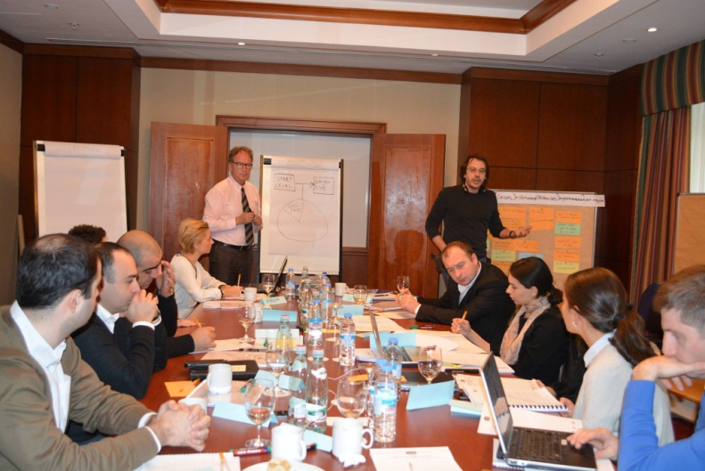
Implemented Activities: Curriculum
Development of curriculum for trainers by the project participants;
Detailed Schedule
Manual for the Trainers
Resources for conducting a training (“Trainers Kit”)

Slide 7
Implemented Activities
dbb Academy experts trained seven Georgian trainers
Detailed training agenda was developed within the Training of Trainers (ToT)
Groups of Trainers were Formed
Participation Certificates were awarded

Slide 8
Trainings in Ethics and Code of Conduct
Trainings for All Line Ministries
Administration of the Government and President
Local Self-governmental Institutions
During the Year 2015 more than 350 civil servants were trained

Slide 9
Code of Ethics – Drafting and Preparation
Working Group
Draft Code of Ethics and Code of Conduct
SIGMA Recommendations
Public Discussions
Adoption

Slide 10
Thank you for Attention!
Irina Aghapishvili
Head of the Civil Service Institutional Set-up and Practice Generalisation Department
iaghapishvili@csb.gov.ge +995 32 2192727

