Slide 1
Local Self-Government In the Republic of Armenia
Kiev, Ukraine
7-8 September 2017

Slide 2
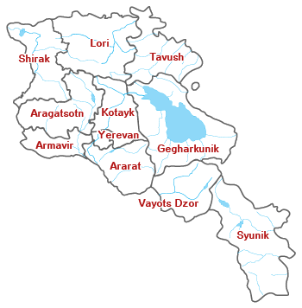
Administrative division of the Republic of Armenia
The territory of the Republic of Armenia is composed of ten marzes (regions) and Yerevan city
Marz governors implement the regional policy of the government. They coordinate the activities of local branches of the executive authority, except as otherwise specified by law.
Aragatsotn
Ararat
Armavir
Gegharkunik
Kotayk
Lori
Shirak
Syunik
Tavush
Vayots Dzor
Yerevan

Slide 3
Legislative system in the field of territorial management
Constitution of the Republic of Armenia
Law of the RA “On Local Self Government in the City of Yerevan’’
Law of the RA“On Local Self-Government” ( Regions)
Law of the RA“On Municipal Service”
Law of the RA“On Local Referenda”
RA President’s decree “On public administration in the marzes of the Republic of Armenia”
Armenia ratified European Charter of Local Self-Government in 2002
…..and other legal acts

Slide 4
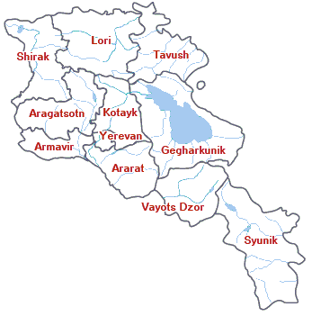
Governmental Reforms of Armenia
Consolidation process of Armenian communities
915
≈ 200

Slide 5
Management of local self-government
Local self-governing bodies
Community council
Community leader
Local self-governing bodies are elected for a five-year term in the communities

Slide 6
Elections in local self-governing bodies
Community council elected representative body
The community leader (in the urban community, the mayor, the community head in Yerevan's community, and the village mayor in the village community) elected executive body of the community

Slide 7
Management of Human Resources
PUBLIC SERVICE
STATE SERVICE
CIVIL SERVICE
JUDICIAL SERVICE
DIPLOMATIC SERVICE
SPECIAL SERVICES
COMMUNITY SERVICE
STATE AND COMMUNITY POSTS

Slide 8
Community Service
Classification of positive community services
Community
Service
Positions
General
Positions
Group
leading
position
Group
Junior
Positions
Group
1st
subgroup
1st
subgroup
1st
subgroup
2nd
subgroup
2nd
subgroup
2nd
subgroup
3rd
subgroup
3rd
subgroup
3rd
subgroup

Slide 9
Who can be a community servant?
Who satisfies the requirements of the community service position
Who knows the Armenian language?
Who is 18 years old
Who is citizens of the Republic of Armenia
….irrespective of nationality, race, nationality, religion, political or other opinion, social origin, property or other status.

Slide 10
Who cannot be a community servant?
Who has been declared incompetent or partially capable of judicial procedure;
Who has deprived of the right to hold a post and / or a post of civil service by a court decision;
Who suffer from a disease that may interfere with the performance of his or her duties and powers;
Who was as found guilty of committing a crime, and the conviction is released from the prescribed action;
Who was prevented by compulsory military service.

Slide 11
Types of attestation
Attestation
Documentary
Testing
and
interview
Corresponds
this post
Corresponds
this post
Not to corresponds
this post

Slide 12
Thanks for attention

