Slide 1
Civil service reforms: improving the efficiency and transparency of the Civil Service in Azerbaijan
Afag Huseyn
dos., head of the department, Civil Service Commission under The President of Azerbaijan Republic
a.huseyn@csc.gov.az

Slide 2

Direction of the reform in civil service
Administrative and legislative : improvement regulatory-legal framework, development civil service code, increasing control, strengthening the principles of meritocracy
Institutional : optimization of the structure and number of CS, merging PB,

Slide 3
Legal Basis
Law of the Republic of Azerbaijan “on Civil Service” was adopted on 21st of July in 2000 .
Law of the Republic of Azerbaijan “on Fighting against Corruption” was adopted on 13th of January in 2004 and came into force from 1st January 2005
Law of the Republic of Azerbaijan “on Rules of Ethics Conduct of Civil Servants” was adopted on 31st of May in 2007
Law of the Republic of Azerbaijan “on Citizen Appeal» was adopted on 30th of September in 2015
National Anti-Corruption Action Plan (2012-2015)

Slide 4
State bodies (Special type)
Prosecutor’s Office | Ministry of Justice
State Border Service | Ministry of National Security
State Migration Service | Ministry of Defense
State field-chasseur service | Ministry of Emergency Situations
State Custom Committee | Ministry of Internal Affairs
National Bank of the Republic of Azerbaijan | Ministry of Taxes
 | Ministry of Foreign Affairs

Slide 5
State bodies (Law on Civil Service)
Category | State body
Superior | Parliament, Constitutional Court, Cabinet of Ministers and Administration of President, Supreme Court
1st | Chamber of Accounts, Judicial-Law Council, Ombudsman of RA*; Parliament of NAR**
2nd | Supreme Court, Cabinet of Ministers, Ombudsman NAR; Appeal Courts, Central Election Commission, Anti-Corruption Commission, National TV and Radio Council and Central Executive Bodies of RA
3rd | State Services and Agencies under the Central Executive Bodies, Regional Centers of Ombudsman, Specialized Courts of RA; Central Election Commission, TV and Radio Council and Central Executive Bodies of NAR
4th | Local executive bodies, local departments of central executive bodies, state bodies under the central executive bodies, local courts
5th | Local departments of the agencies, services or other state bodies under the central executive bodies, offices of the representatives of the heads of local executive bodies
* RA – Republic of Azerbaijan
** NAR – Nakhichevan Autonomous Republic

Slide 6
Positions | Type of position | Recruitment type | Available in state bodies of grade
 |  |  | S | 1st | 2nd | 3rd | 4th | 5th
Superior | Administrative | Promotion or interview | X
1st CAdP |  |  | X | X
2nd CAdP |  |  | X | X |  | X
3rd CAdP |  |  | X | X | X | X
4th CAdP |  |  |  | X | X |  | X
5th CAdP |  | Competition |  |  | X | X | X
6th CAdP |  |  |  |  |  | X | X | X
7th CAdP |  |  |  |  |  |  | X | X
1st CAxP | Auxiliary | No special recruitment procedures | X
2nd CAxP |  |  |  | X
3rd CAxP |  |  |  |  | X | X
4th CAxP |  |  |  |  |  |  | X | X

Slide 7
Professional ranks | Given by | Administrative |  |  |  |  |  |  |  | Auxiliary
 |  | S | 1 | 2 | 3 | 4 | 5 | 6 | 7 | 1 | 2 | 3 | 4
Full state counsellor | President | X
State counsellor of the 1st rank |  | X | X
State counsellor of the 2nd rank |  | X | X | X
State counsellor of the 3rd rank |  |  | X | X
Chief civil service counsellor | Head of the state body |  |  | X | X
Civil service counsellor |  |  |  |  | X | X
Junior civil service counsellor |  |  |  |  | X | X | X
Civil servant of the 1st rank |  |  |  |  |  | X | X | X
Civil servant of the 2nd rank |  |  |  |  |  |  | X | X | X
Civil servant of the 3rd rank |  |  |  |  |  |  |  | X | X
Junior civil servant |  |  |  |  |  |  |  |  | X
Chief civil service referent |  |  |  |  |  |  |  |  |  | X
Senior civil service referent |  |  |  |  |  |  |  |  |  | X | X
Civil service referent of the 1st rank |  |  |  |  |  |  |  |  |  | X | X | X
Civil service referent of the 2nd rank |  |  |  |  |  |  |  |  |  |  | X | X | X
Civil service referent of the 3rd rank |  |  |  |  |  |  |  |  |  |  |  | X | X
Junior civil service referent |  |  |  |  |  |  |  |  |  |  |  |  | X

Slide 8
e.gov.az - ELECTRONIC STATE
The legal base of electronic state system is created.
By means of electronic government (E-government) portal more than 400 electronic services are carried out.
The subsystems of the Electronic State operate- electronic government and electronic judicial authority.

Slide 9
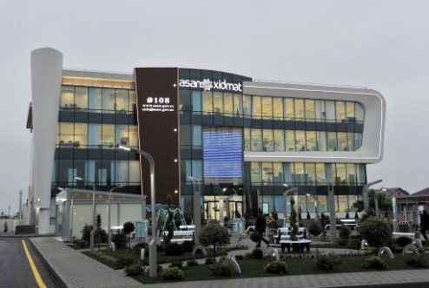
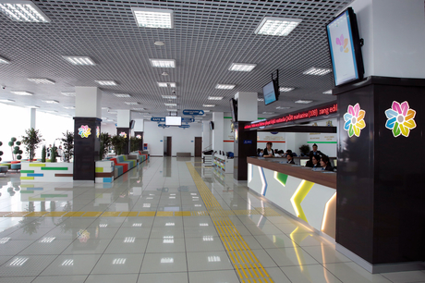
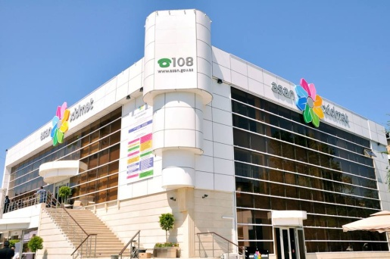
Principle of «single window»
State Agency for Public Service and Social Innovations under the President of Azerbaijan Republic
Established by the Decree of the President of the Republic of Azerbaijan No.685 dated 13 July 2012
Coordinates and carries out an assessment of the state agencies providing services
For the last 2 years more than 4 million people benefited from the services

Slide 10
Amount of civil servants in Azerbaijan for 2015 is 30108 person, among them

Slide 11

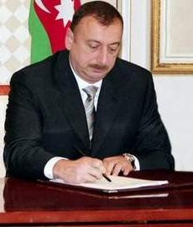
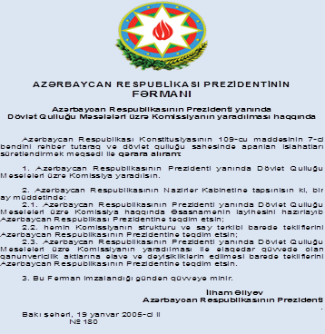
Civil Service Commission was established according to the decree No 180 of the President from January 19, 2005
Civil Service Commission is a central executive power body which is under direct subordination of the President and reports to the President

Slide 12
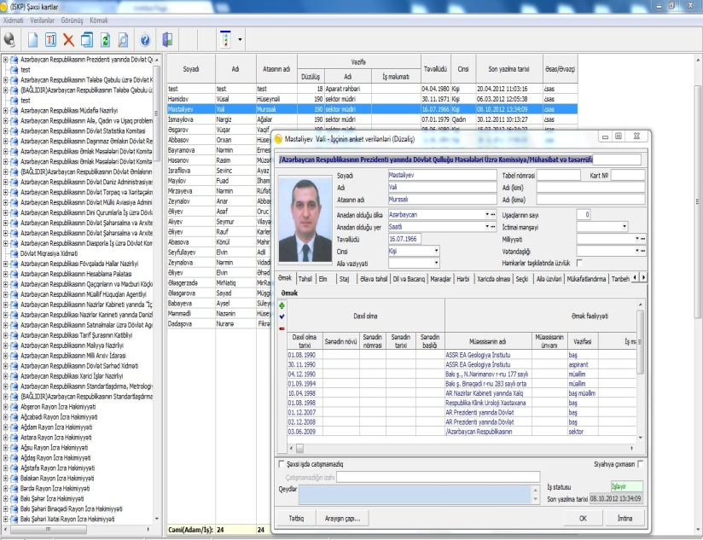
Maintenance of the Civil Servant Register together Civil Service Commission with the Administration of the President
Basic function possibilities of register
Automation of storage and display of information about civil servants and public positions;
Automation of changes in the register of civil servants with the change of personal information of civil servant;
Verification the legality of the changes in the register of civil servants;
Automation of vacant positions
Automation of forming and printing out statements from the register of civil servants

Slide 13
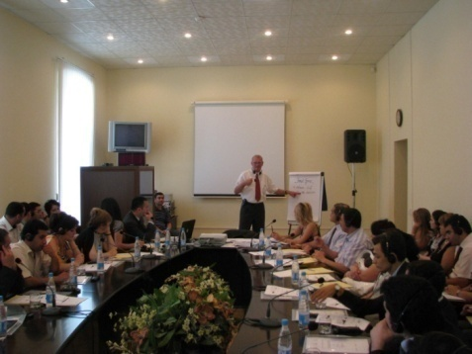
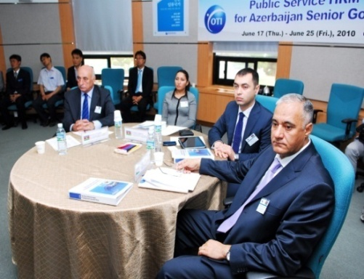
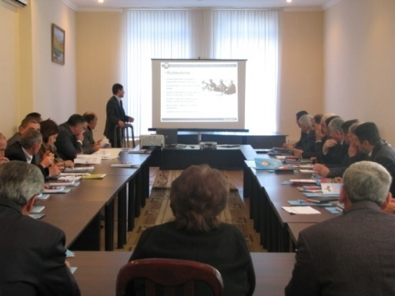
Professional Development of Civil Servants
Coordination of state bodies’ activities
Analyze training needs of civil servants and development of training strategy
Organization of short-term trainings and study visits on administration field, etc.

Slide 14
Thank you for your attention!

