Slide 1
Modernization
of Civil Service
in the Republic of Moldova
Ecaterina NEGRU,
State Chancellery of the Republic of Moldova
February, 19^{-th}, 2016

Slide 2
RAPC: MRU
Approach
Management of civil service positions and civil servants – systemic approach:
Legal framework (laws, regulations, rules)
Administrative and methodological framework (personnel procedures/practices)
Institutional framework (entities responsible for HR management)

Slide 3
RAPC: MRU
General Legislation
Law on the public office and status of civil servant (no. 158/2008)
Government decision on the enforcement of Law no. 158/2008 (no.201/2009)
Government decision regarding the secretary of state (no.155/2014) etc.
Law on the civil servant’s code of conduct (no. 25/2008)
Law on the conflict of interest (no. 16/2008)
Law on the approval of the single classification of civil service positions (no. 155/2011)
Law on the pay system in civil service (no.48 /2012)
Law on declaration and control of income and property (no. 1264/2002)

Slide 4
RAPC: MRU
Special Legislation
Law on the status of political appointees
(no. 199/2010)
Law on the status of staff in the cabinet of political appointees (nr. 80/2010)

Slide 5
RAPC: MRU
Government Decision 201/2009 (1)
Regulatory act approved by the Government that represents by itself a separate “code for civil servants”, though it does not bear this title
It describes almost all personnel procedures applicable to civil servants

Slide 6
Decision 201/2009 (2)
Regulation on competition-based employment to civil service (annex 1)
Regulation on the probation period of junior civil servants (annex 2)
Standardized job descriptions and methodology on drafting, coordination and approval of job descriptions (annex 3)
Rules for part-time work of civil servants (annex 4)
Standardized staff lists and methodology on staff list development and endorsment (annex 5)

Slide 7
Decision 201/2009 (3)
How to draft the written commitment to work in civil service (annex 6)
Regulation on disciplinary commission (annex 7)
Regulation on performance appraisal of civil servants (annex 8)
Framework Regulation of HR units in public authorities (annex 9)
Regulation on ongoing professional development of civil servants (annex 10)
Instruction on civil servant’s personal file management (annex 11)

Slide 8
RAPC: MRU
Collective performance appraisal Government Decision 94/2013
Organized on a biannually basis
It provides the assessment of the public authority unit and not of the civil servant
Incentive management tool

Slide 9
RAPC: MRU
Monitoring the enforcement of legislation related to civil service positions (State Chancellery)
Development of Annual Monitoring Plan (rotation)
Monitoring visit to the public authority
Development of monitoring report indicating the rating (low, medium, high)
Submission of report to public authority with recommendations

Slide 10
RAPC: MRU
Methodological Support
Guidelines
Newsletter (electronic)
Consultations
1:1 assistance
Exchange of experience
Informative publications
HR practitioners network

Slide 11
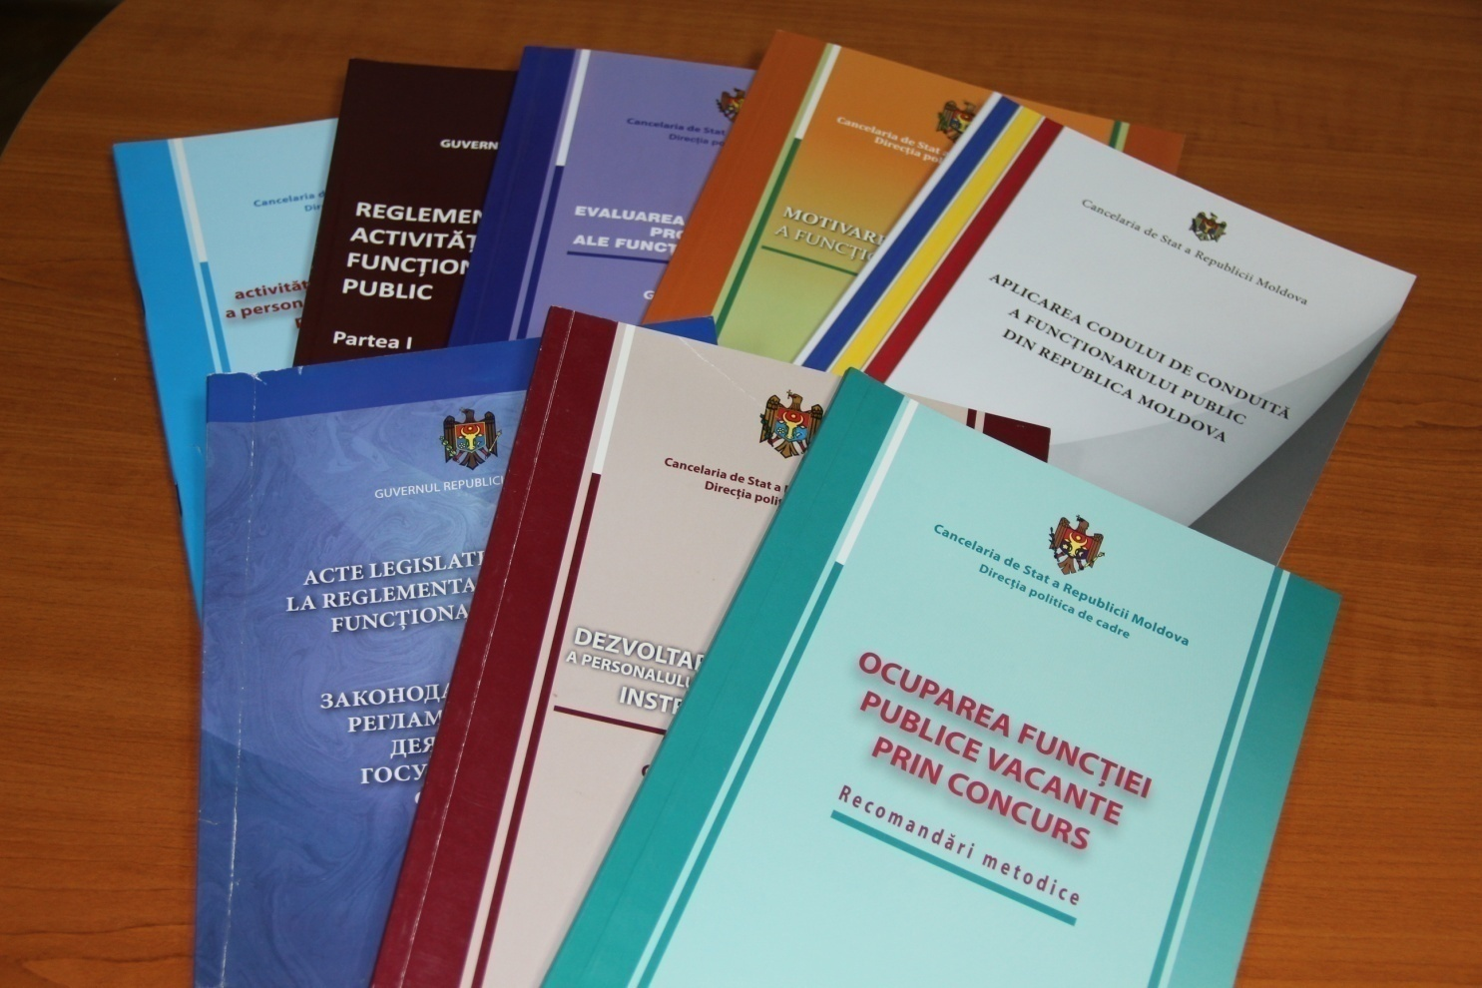
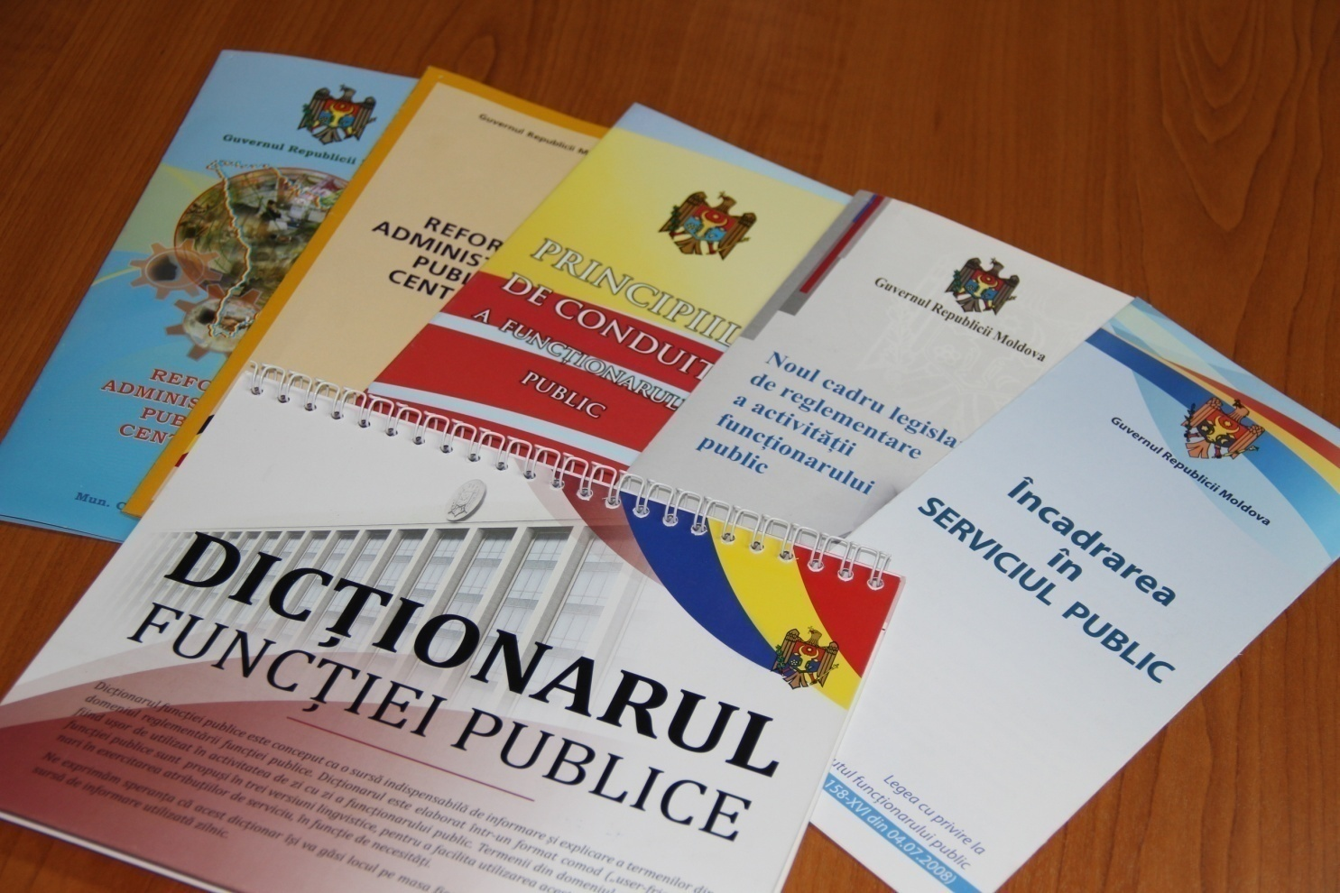
RAPC: MRU
Methodological Support - Guidelines

Slide 12
RAPC: MRU
Methodological Support – HR practitioners network
Meetings
Biannually,
with local public authorities
Quarterly,
with central public authorities

Slide 13
Digitization of HRM Procedures/Processes
Register of civil servants and civil service positions AIS – GD 106/2014
Job opportunities website – GD 1022/2013 (www.careers.gov.md)

Slide 14

Digitization of HRM/Procedures/Processes AIS RCSCSP
AUTHORITY
PERSONNEL RECORDS
LEAVES AND BUSINESS TRIPS
PROFESSIONAL BACKGROUND
SEARCH
AND REPORTS
Leaves
Business trips
Establishment data
Head
Number of employees
Organizational chart
Positions
Employee
Service relations
Employment contract
Employment management
ID cards
Events calendar
Objectives
Individual performance appraisal
Motivation
Sanctions
Trainings
Search
Report
Cognos
Register of civil servants and civil servant positions AIS
Job opportunities website (www.careers.gov.md)

Slide 15
Institutional Framework
Central level
  Management of the State Chancellery, specific ministries
  CPAR Division (within State Chancellery)
  +
Public authority level
  Head of public authority
  HR unit

Slide 16
Major Achievements
  Legal and methodological foundations for a professional and meritocratic civil service created
  Civil service reform has entered the implementation phase
    Horizontal perspective – uniform and correct
    Vertical perspective – to the attitude level
  Prerequisites for sustainability in place

Slide 17
Ensuring Sustainability: Areas of Intervention (1)
Correct and uniform implementation of regulatory framework:
  Institutionalization of a monitoring and evaluation system
Delineation of political and administrative positions:
  Institutionalization of the „secretary of state” position
  Implementation of the Management Development Program
  Continuation of reforms
Implementation of performance management at organizational level (public authority)
Ensuring transparency and access to civil service positions, using modern technologies

Slide 18
Ensuring Sustainability: Areas of Intervention (2)
Design and implementation of changes in areas identified as important: integrity of civil servants, talent management, management accountability, staff turnover etc.
Building civil servants’ skills – implementation of the National Training Program
Building the skills for civil service and change management: central level – State Chancellery; public authority level – state secretary, HR unit

Slide 19
Thank you for your attention!
Visit us!
web pages:
www.cancelaria.gov.md
www.justice.gov.md
email: drapc@gov.md

