Slide 1


The human resource management automation of the public service in the Republic of Belarus

Slide 2

The plan
Rationale: premises and reasons;
Public service in Belarus;
Software, used in human resource management automation;
Targets to succeed.

Slide 3
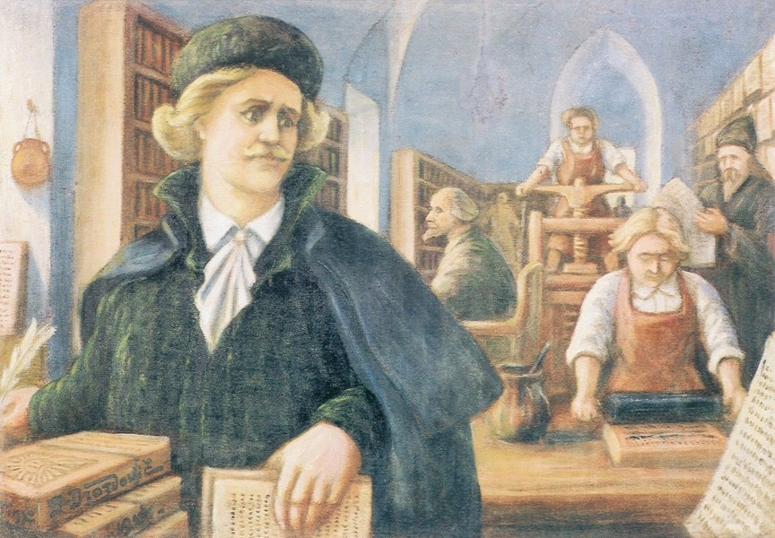
High pace of development:
  the current state of affairs advocates swift actions;
Cost-effectiveness;
  thanks to Hi-tech it is possible to spend less public funds on the civil servants;
Optimization:
  the bulk of work can be decreased due to the systematization of information, made by Hi-tech.
Image 1. Francysk Skaryna, printing pioneer of the Eastern Europe, XVI century
Reasons for the advent of new technologies

Slide 4


Legal basis: Constitution, “Public service Act” 2003, specific legal instruments;
HR-office of State’s bodies is in charge of numerous functions:
  to keep and render personal data files, labour pools, accountings,
  to exercise control over the observation of restrictions and workplace discipline,
  to support the work of the contest committee;
  to elaborate and to ameliorate the structure of organization as well as the payroll schedule;
12 grades;
Public service (as defined by the Act) is a professional activity of the persons, holding public offices, exercised for the direct realization of public powers and for the enforcement of the State’s functions.
Public Service
in the Republic of BELARUS

Slide 5


edrfg
AIS Reserve – automated information system;
Personal business;
HR+;
HR management
Efficiency;
Comprehensible interface;
Actual data;
Unity.
Software used

Slide 6


HR-Community in Belarus
3rd Belarussian forum on HR-management;
Journals: “Human resources”, “HR manager”, “I’m an expert in HR”
collaboration;
expertise and best practices;
reciprocity

Slide 7

Conclusion
IT has always been on the top of agenda in Belarus;
Modern and advanced technology is an essential prerequisite to succeed;
Progress rests on consciousness

