Slide 1
HR data management in the Polish Civil Service: state of play and development perspectives
Competency Centre of State
28th of November, Kiev

Slide 2
Short brief
1st of January
DG of the Offices send reports to the Head of The Civil Service
1st of February
The Head of The Civil Service with Civil Service Department proces those informations
End of March
Prime Minister gets the report
End of June
Prime Minister accept report or refuse to do so
Act of 21 November 2008 on Civil Service
Polish Civil Service
1832 offices;
117 964 employees.

Slide 3

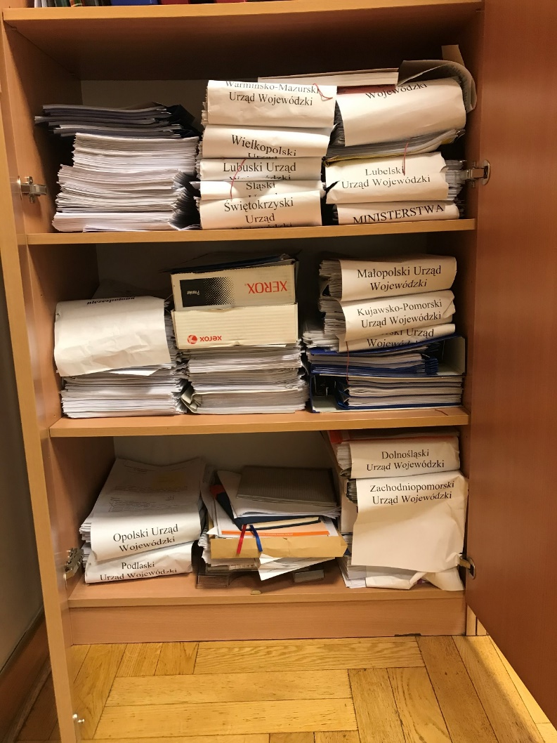
What was before 2011?

Slide 4
Competency Centre of State (CKP)
3802 users;
Costly and time – consuming updates;
Except registration paperless
CKP
Regional Police Headquaters
Local Police Headquaters
Local Police Headquaters
Ministries
Provinence
Officec
KPRM
…

Slide 5
Future plans
Registration component;
Integration component;
Reporting component;
Outcome component;
Archive component;
Communication component.

Slide 6
Thank you
Mateusz Pawelec
Civil Service Department
The Chancellery of The Prime Minister
mail: mateusz.pawelec@kprm.gov.pl
Notes:
Ostatni slajd zawsze wygląda tak jak powyżej ☺

