Slide 1
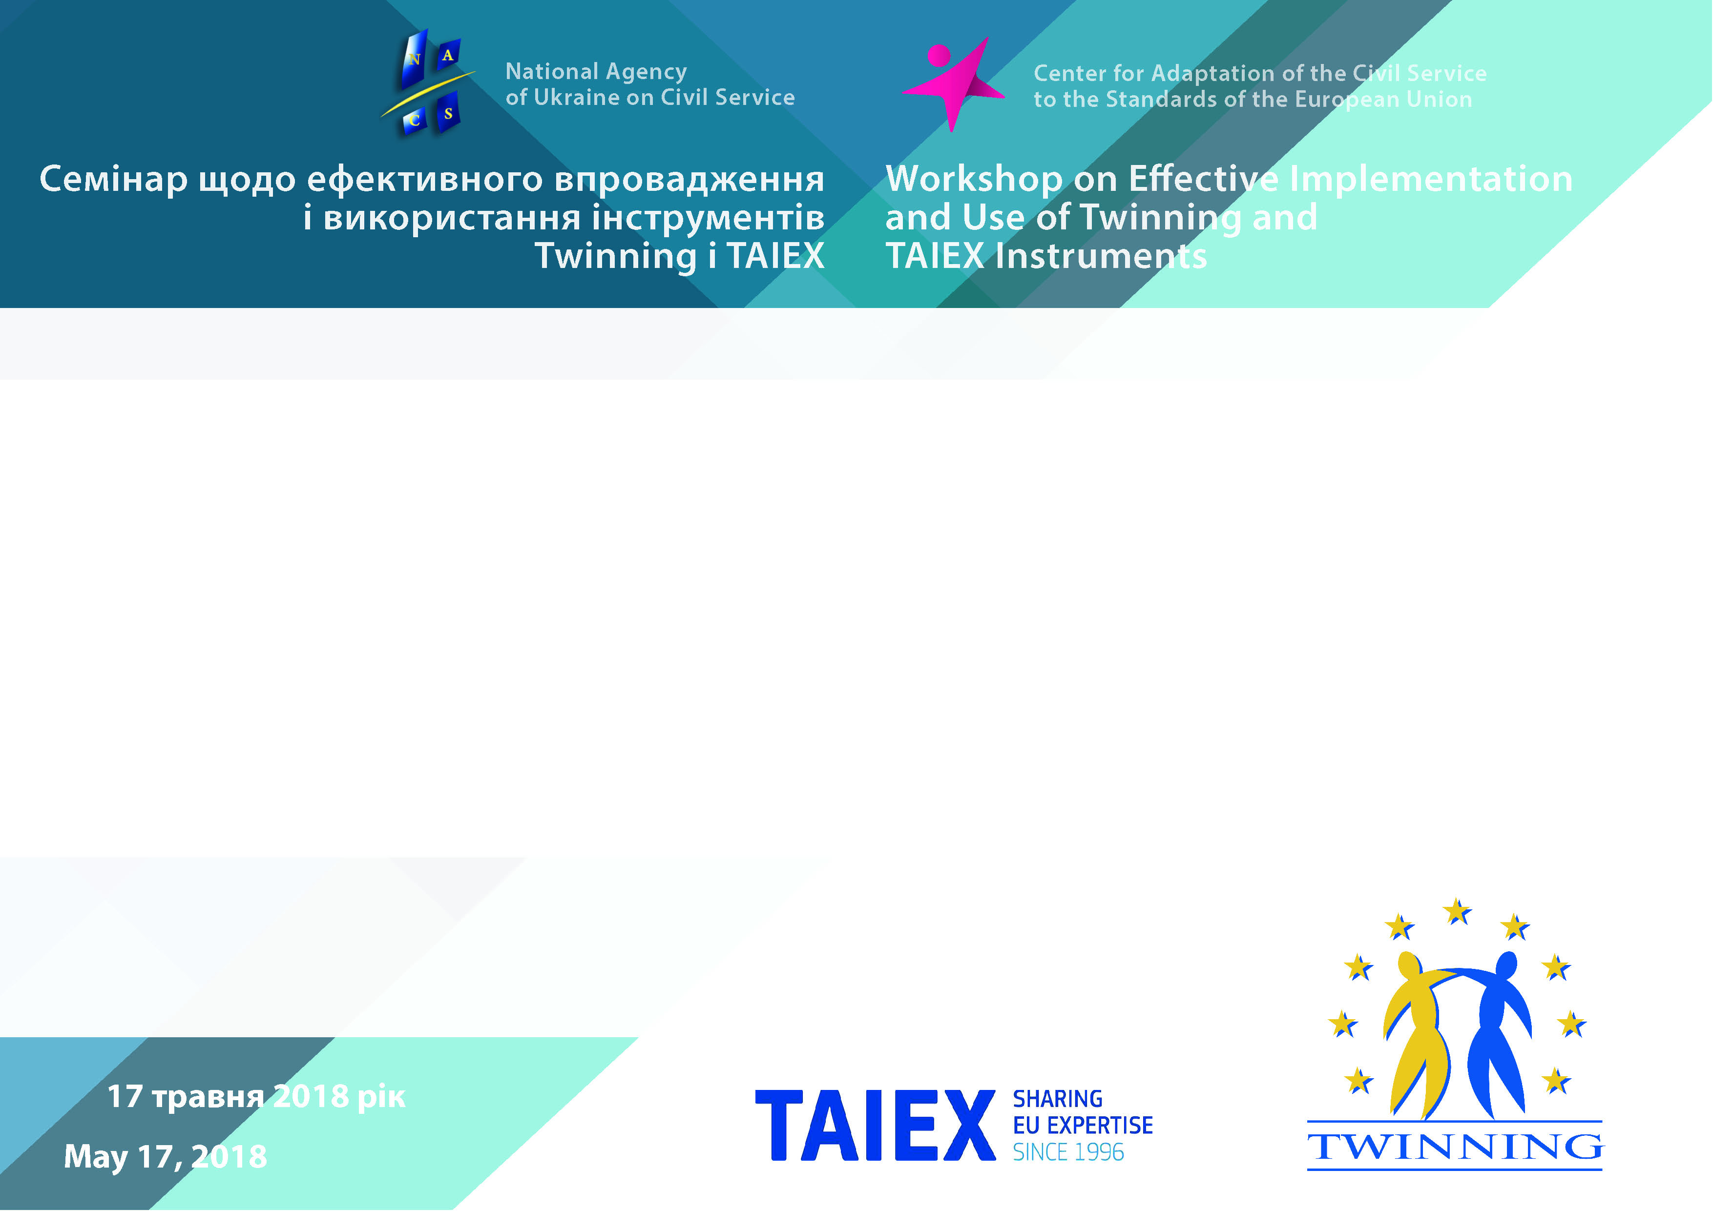
Experience of European Institution Building Instruments Twinning, TAIEX Implementation and SIGMA Programme Realization in Ukraine
Maryna Kanavets,
Director of the Center for Adaptation
of the Civil Service to the Standards
of the European Union/
Director of the PAO

Slide 2
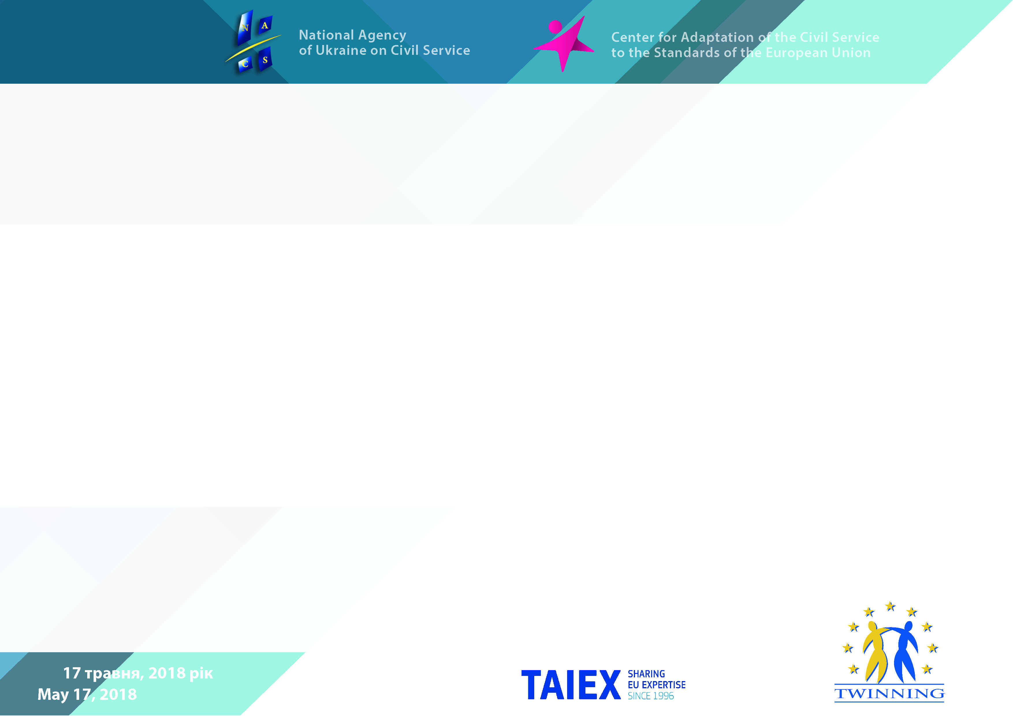


Slide 3
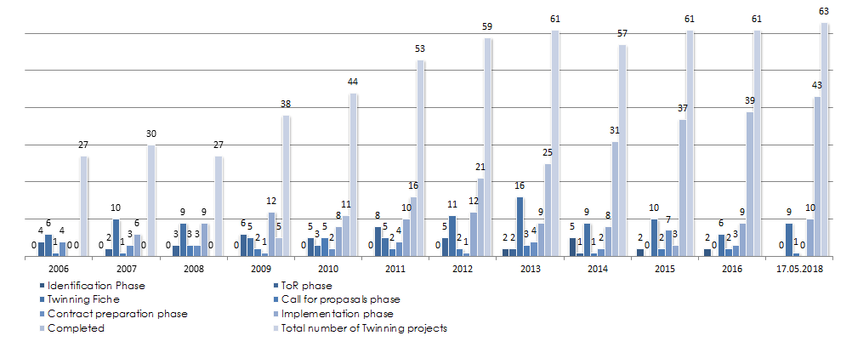
Dynamics of Twinning Projects

Slide 4
Twinning Projects Work Plan

Slide 5
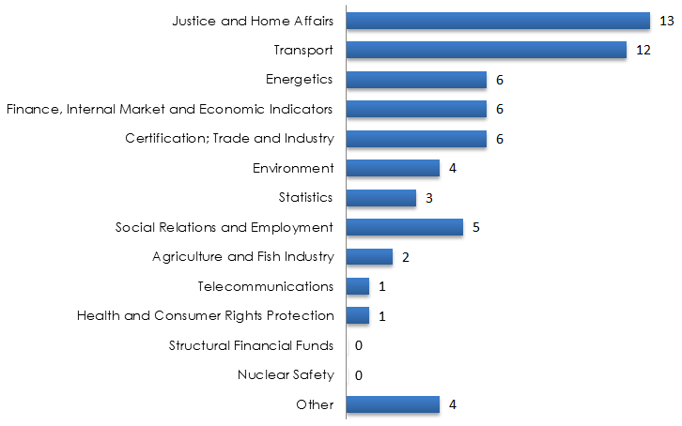
Areas of Twinning Involvement

Slide 6
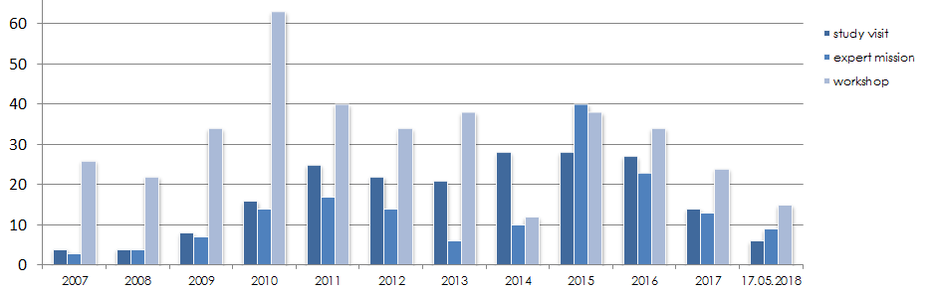
TAIEX Activities per Types of Events

Slide 7
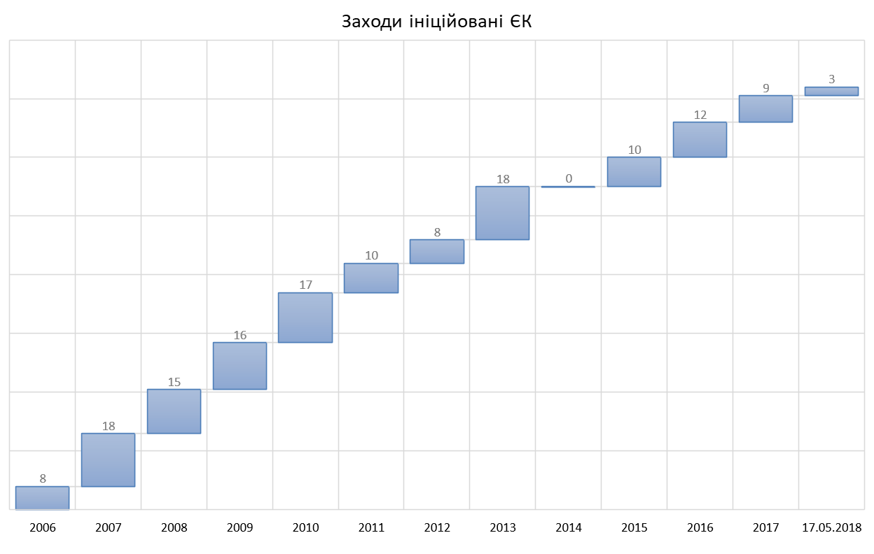
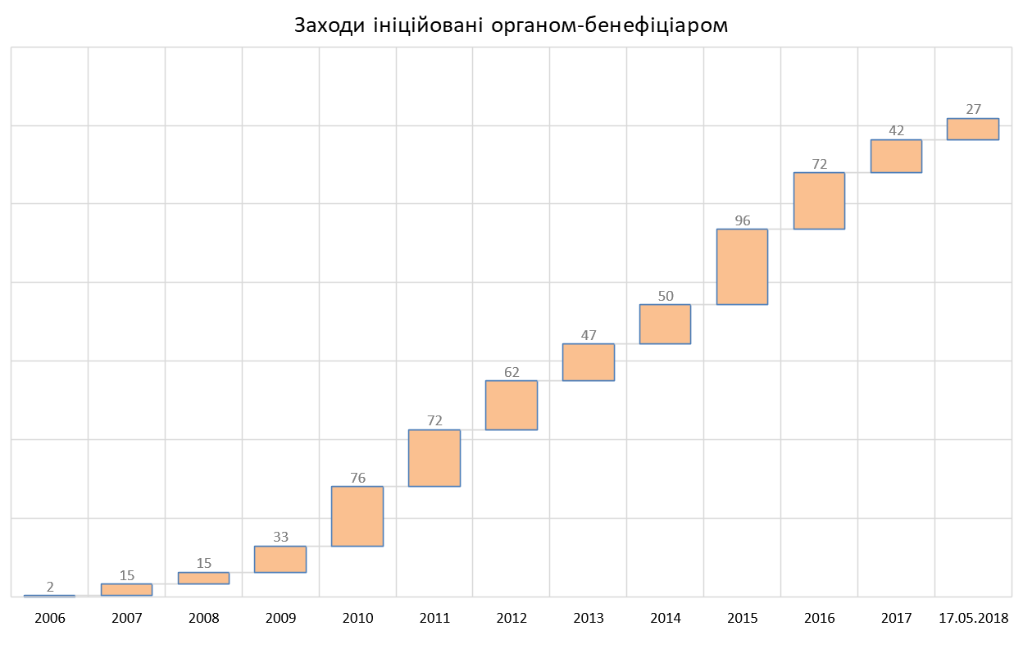
Initiators of TAIEX Activities
Events initiated by the European Commission
Events initiated by the Ukrainian government authorities

Slide 8
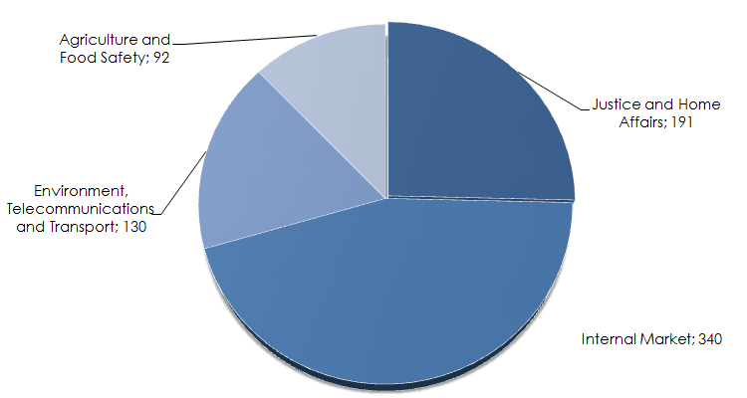
TAIEX Activities per Sector

Slide 9

Cooperation with SIGMA Programme
OECD/SIGMA Programme Fact Checking Mission on Assessment on Public Administration in Ukraine (25 April, 2018)
OECD/SIGMA Programme Fact-Finding Mission on Assessment on Public Administration in Ukraine (19–22 February, 2018)

Slide 10

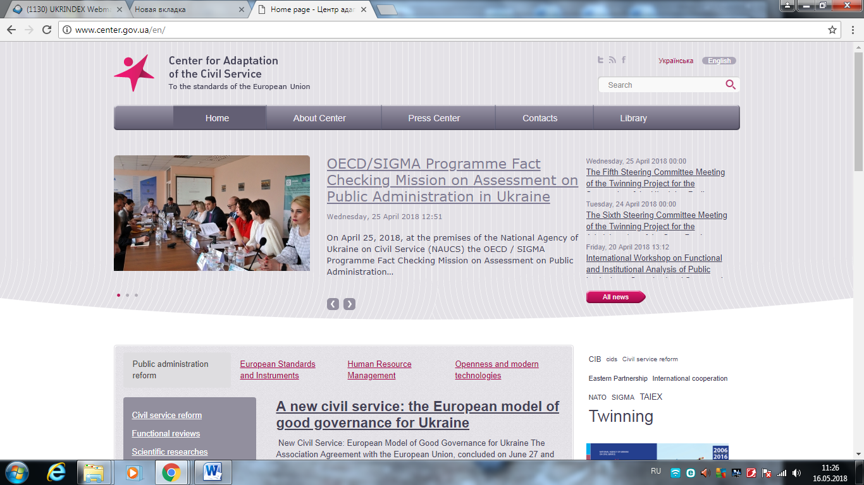
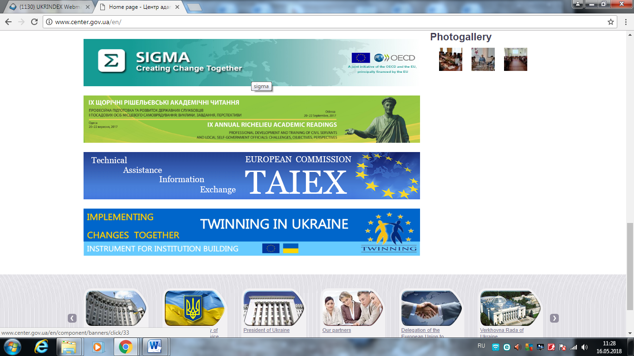
Official Web-Site of the Center

Slide 11

Center for Adaptation
of the Civil Service
to the Standards
of the European Union
tel./faxс: (044) 278-36-44
pao@center.gov.ua
taiex@center.gov.ua
www.center.gov.ua

