Slide 1



Practical advice on Twining working methods and management issues
Presentation to
Ukrainian Institutions
Twinning after Manual 2017
DG Enlargement – Unit D2
November 2013
Claus Lech
Team Leader Twinning
DG NEAR – Unit C 3
Notes:
Present yourself and your background.
Good morning, my name is

Slide 2
Nothing is possible without individuals.
Nothing is lasting without institutions
Jean Monnet
("men" changed to "individuals")

Slide 3
What is particular about “Twinning”
Twinning is a tool for institution building
- Where a joint effort by homologues from a Partner Country administration and one/more EU Member State administrations
- creates a partnership between staff in a Partner Country administration and their homologues in one/more EU MS
Notes:
A Twinning is a project between Public Administrations – from European Union (EU) Member State(s) (MS) and the similar Public Administration form a Partner Country in the Pre-accession (IPA) Region or neighbourhood Region. (ENI)

Slide 4
What is particular about “Twinning”
- where the partners in the programming has defined objectives and mandatory results to be achieved based on requirements agreed in the policy dialogue
- making the partners jointly responsible for the results but only the Partner Country for sustaining these
The selection is not based on price, but on methodology, structure, the quality of the RTA and the accessibility to expertise defined by the EU MS (not ST CVs)

Slide 5
What is particular about “Twinning”
All EU MS are consulted at same time via the Network of National Contact Points (usually in MoFA) in all EU MS
A majority of costs are pre-defined in a Commission Decision as compensation to the EU MS engaging.
Work-plans are jointly developed after the Partner Country has selected its partner.
A Twinning Review Mission will check status 6-12 months after project has ended. Are results sustained?

Slide 6
Twinning – Lessons learnt
Twinning Reform focussed on
Simplification of all processes
Speed (contracting and start) & Flexibility (implementation)
Common rules for Twinning for IPA/ENI
A solid and simple Compensation model for all EU MS
Protecting the key concepts behind Twinning
One year down the line – lessons learned – practical recommendations

Slide 7
Twinning - Always remember ….
0. Institutional setting and political implications
The EU MS are always represented by a high level appointed Project Leader empowered to commit the EU MS or body engaging
The RTAs are usually supervised by this EU MS PL and in frequent if not daily contact with the PL.
The whole Twinning cycle is closely monitored by National Contact Point(s) established (usually in the MoFAs) in each EU MS and PC
EU HQ relevant services are always involved in project definition.

Slide 8
Twinning – Project Cycle
1. Programming – key elements
Ensure political support from the top, reiterate link to agreements in the policy dialogue and justify how this contributes to ongoing reforms
Define why Twinning is the best tool in the toolbox for the sector/subsector you want to change and ensure that you on the PC side have the capacity to handle (HR, funds etc) and absorb
Ensure complementarity with other on-going actions (donors/ PC own initiatives) and analyse sequencing and non-dependency on results of other (TA/SUP/WORKS/Grant) projects/investments.

Slide 9
Twinning – Project Cycle
2. Project Preparation - key elements
Put realistic results and focus on the most important. Use the best expertise to assist you to define.
Define objectives and results not activities
Indicate key project milestones but don’t detail sequencing
Consider EUD and MS Embassy engagement in the communication/visibility planning
Carefully analyse the need for study tours.
Notes:
Use best expertise to assist on the Twinning Fiche description.

Slide 10
Twinning – Project Cycle
3. Publication, proposals and Selection of Partner
Publish the call and send it to call EU MS NCPs as soon as you have the OK by the Twinning Inter-Service Group in EU HQ. React as quickly as possible to the ”opinion” given by EU HQ.
Focus your selection of partner on the one best fitting needs/wishes – meaning focus on the offered methodology, structure used by EU MS, the quality of RTA and the accessibility to expertise defined by the EU MS – do not focus on costs – they are to be a large extent regulated in the Commission Decision.

Slide 11
Twinning – Project Cycle
4. Contract
PC and MS and CA to agree a detailed contract preparation timetable - the selected partner has to provide all information for the contract asap.
Contract at the signature stage is ”sketchy” and only defined at budget heading level and the flat rate budgetlines (contingency/reserve 2,5% and flat indirect 6%) -> Process an addendum after the first Steering Committee
Since all contract cost details - for the first 6 months is only developed at the time when the initial rolling work-plan is agreed

Slide 12
Twinning – Project Cycle
5. Implementation
- The rolling work plan is the key document for all partners defining what, when, who, where for six-months rolling periods. Invest sufficient resources in developing it.
- A Steering Committee meeting every 3 months is composed of high-level representatives from the Partner Country and the EU MS(s) – (PLs) – steers the project and approve all work-plans. Do dedicate more time to prepare for these. At each SC carefully monitor remaining funds.
- For all Steering Committees all relevant stakeholders in the sector/sub-sector in which the project works, should be invited as observers for the Committee. Do analyse and involve the EUD when discussing who should be part (as observers).

Slide 13
Twinning – Project Cycle
- The Partner Country should check at Twinning Fiche stage and recheck well before the RTA arrival that adequate office space, meeting rooms etc are available.
- Partner country RTA Counterpart should be fully available and make sure that the RTA is assisted until RTA Assistants recruited
- All partners should engage fully in work-plan preparations as soon as the RTA has arrived – remember to ensure all related departments are on board
- Set aside sufficient time for discussing communication/visibility
- Involve all relevant departments/agencies/institutions in the work-programme planning – public reforms are rarely limited to only one entity (ex - customs -> revenue - taxes - police etc)

Slide 14
Twinning – Project Cycle
6. End of project and evaluation of results
- Final reports always deliver a set of recommendations for the Partner Country to take after end of project
- The Partner Country administration should carefully plan (also ask resources to implement) such follow up activities
- A Twinning Review Mission is then undertaken 6-12 months after project end
- Twinning project are in addition evaluated as part of larger (sector/global) HQ-evaluations.
- Elgibility of costs under Individual Twinning contracts are randomly checked by auditors.

Slide 15
Standard Twinning
Reminder
Project involves a resident twinning
adviser (RTA) from 12 up to 36 months,
and a number of short-term experts
coming from the EU MS administration(s) implementing the twinning...
The mobilisation of both administrations is ensured through the designation of their respective project leaders (high level civil servants) the MS PL and Partner Country PL.
Budgets (averages) between 1,5 and 1,8 M€

Slide 16
Twinning Light
Reminder
No RTA
8 months (exceptionally up to max 10)
A PL and a number of short-term experts from the EU MS administration(s) implementing the Twinning...
The mobilisation of both administrations is ensured through the designation of their respective project leaders (high level civil servants) - the MS PL and Partner Country PL.
Max budget: 250.000€

Slide 17
Manual Update June 2018
Currently processing a revised manual – not changing any core principles/concepts, but
Clarifying
Adding more examples
Giving further details
Ensuring full text coherence
Adding a contractual element – required by CoA
Updating references (new Regulations etc)

Slide 18
Further material for studying

Slide 19

Twinning means engagement by …
Twinning stakeholders
Public administrations (and Mandated Bodies)
MS NCP
Beneficiary Administration(s)
CFCU (IPA)-PAO-offices (ENI)
EU Delegation (Twinning focal point/Press and information Officer/PAR coordinator)
EC Headquarters (DG NEAR, C3)
Project Leaders, Resident Twinning Advisers, Component Leaders,
Short Term Experts
Other donors/partners

Slide 20
PC Administration, CA, EUD and EU HQ have crucial roles
Who does what?
The Partner Country administration is the one reacting to requirements/needs arising from the policy dialogue with EU and/or reform developments in the the Partner Country
Contracts are signed by the Contracting Authority and the EU MS PL, - and Work-plans are also signed by EU MS and PC Project leaders.
Role of Contracting Authority (CA)- always to be the one to circulate the fiches to MSs (standard and twinning light) and always the entity preparing the contract
Publication always by EUD even if indirect management mode;
HQs entities gives an Opinion on the fiche
Selection procedure is by consensus – also acceptance by EUD;

Slide 21
Type of Activities
What actions?
The rolling work-plan will likely consist of actions línked to:
- Legal harmonisation or approximation
- Contribution to policy/strategy documents
- Standards/norms/accreditation/certification/best practice
- Institutional capacity building
- Mission of Short term experts
- Study visits, Trainings and Internships
- Communication/Visibility actions
- Workshops (NB: Complementarity (incl TAIEX)

Slide 22
The Selection Meeting
How to select?
Both the written proposal and the oral presentation will be assessed.
The PC delegation should include at least the Project Leader and RTA counterpart and the BC NCP (PAO, CFCU); The MS delegation should always include the proposed Project Leader and RTA(s).
During the selection meeting, for each proposal approximately 45 minutes are given to the presentation of the MS and 30 minutes for Q/A.

Slide 23
Rolling Workplan and corresponding budget
Planning the implementation?
Prepared by the RTA and RTA Counterpart upon arrival of RTA, the first six months duration rolling Work plan consisting of a sequence of activities and CVs of short term experts, is approved during first steering committee and reviewed/updated quarterly. Invest sufficient time, energy and political commitment.
The Twinning work plan details the relevant organisation and methods, including work and time schedule, a very precise division of tasks between the partners and a detailed breakdown of costs. At each Steering Committee meeting carefully monitor remaining funds vs mandatory results

Slide 24
Costs covered and Communication/Visibility
Costs and Visibility
A Commission Decision - regulates the costs under Twinning and defines how to ensure that Twinning operates on No-profit principles as per EU Financial Regulation. EU MS are compensated.
Communication/visibility - Twinning projects are not bilateral but EU projects – but can of course later be followed by bilateral projects. Reach out to the Public – agree a Communication /Visibility Plan with the EUD. Involve appropriate political levels.
NB: Always consider how Twinning and TAIEX can complement each others - no duplication allowed

Slide 25
Role of EU HQ
EU HQ –TISG process
Twinning Coordination Team monitors all Twinning implementation, advises, statistics, conflicts (if EUD cannot)
- Reviews the Twinning fiche already approved by the PAR manager appointed by the Contracting Authority and subsequenlty sent to the Twinning coordination team
- Ask further reviews to the line DGs, CoTEs (including PAR), TAIEX country coordinators in C3, GEO desks and EEAS (the same entities being involved also in sector policy dialogues)
- Ensures that an opinion on the fiche is issued to the Contracting Authority in time. The Opinion can be:

Slide 26
Opinion on Twinning Fiche
EU HQ opinion
1 Full approval: the Twinning Fiche is approved as submitted and can be circulated;
2 Approval with Comments: the Twinning Fiche is approved, but improvements and/or adaptations could be introduced before circulation;
3 Conditional approval: the Twinning Fiche is approved, but specific amendments must be introduced by the Contracting Authority before circulation;
4 Rejection: the Twinning Fiche is rejected and all parties involved in its preparation are invited to re-submit a modified draft to the Twinning Inter-service group.

Slide 27
Evaluation of results
Twinning Review Missions
EU Delegation/CA triggers
Based on Final Report of project
2 experts (RTA + former RTA or other expert)
App. 5 days
Obligation to provide a report.
Organized and financed by TAIEX

Slide 28
Twinning history
Accession Countries
Launched in May 1998 to support the Partner Countries having applied for accession to the EU family of Member States (accessions 2004, 2007) (Phare->IPA)
Accession criteria:
- Copenhagen Criteria setting the criteria for Membership of the EU related to the applicants was established in 1993 and includes that for a country to accede it must accept the Union Acquis
Tight resources and timetable -> focus on hard acquis ->
-> focus on legal harmonisation

Slide 29
Twinning history
What is the Union Acquis?
The acquis is the body of common rights and obligations that is binding on all the EU member states. It is constantly evolving and comprises:
  the content, principles and political objectives of the Treaties;
  legislation adopted pursuant to the Treaties and the case law of the Court of Justice;
  declarations and resolutions adopted by the Union;
  instruments under the Common Foreign and Security Policy;
  international agreements concluded by the Union and those entered into by the member states among themselves within the sphere of the Union's activities
Notes:
NB: Hard Acquis and Soft Acquis

Slide 30
Twinning history
  ENI
Twinning expanded to also work with Neighbourhood countries In 2004 – and in future could be expanded further.
Twinning in ENI countries responds to cooperation or other agreements of very different nature. 20 priorities by 2020. Belarus first project in 2017.
Focus – often more on Economic Development and standard/norms for trade etc (customs standard etc)
Notes:
In 2004 The Twinning instrument was also made available to Neighbourhood countries
It aims at upgrading/modernising an administration though training, reorganisation as well as drafting of laws and regulations through legal approximation
...and to respond to agreements (cooperation or association).

Slide 31
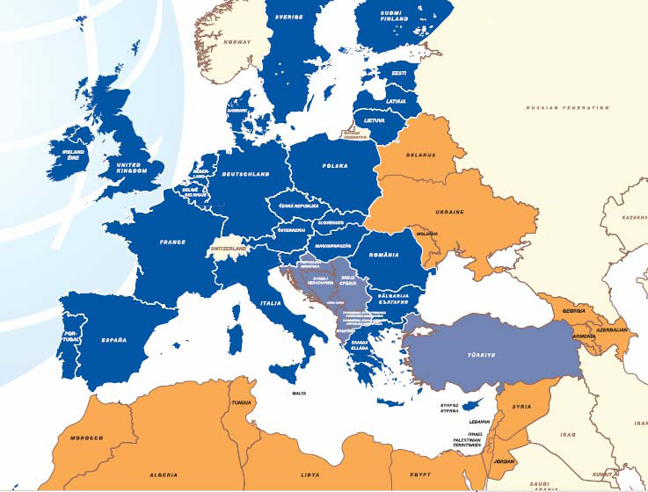
WHERE?
IPA
EU MS 28 countries
Instrument for Pre-Accession Assistance (IPA)
(in light blue)
7 partners
Albania
Bosnia and Herzegovina
Kosovo*
Montenegro
Serbia
Turkey
the former Yugoslav Republic of Macedonia
∗ This designation is without prejudice to positions on status, and is in line with UNSCR 1244 and the ICJ Opinion on the Kosovo Declaration of Independence
Notes:
Croatia special case conferred management power without ex ante control, very active in circulating Twinning fiches mostly TWG lights until December 2016 and participating in calls most of the time as junior partner
Iceland

Slide 32
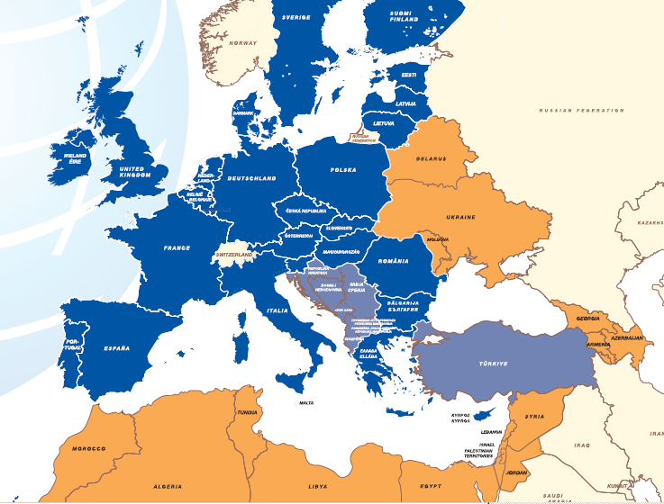
WHERE ? ENI
ENI
 | ENI Countries (in orange) Morocco Algeria Tunisia Libya* Egypt Israel Palestine Jordan Lebanon Syria* Armenia Georgia Azerbaijan Ukraine Moldova Belarus

Slide 33
Twinning in numbers since 1998 IPA+ENI
Budget expenditure
Twinning projects circulated
Main sectors
More than €2 Billion
Justice, Agriculture,
and Finance
More than 2,700

Slide 34

More information available on:
Twinning website: http://ec.europa.eu/twinning

Slide 35
Questions?

