Slide 1
What Have We Gained from the Framework for
Cooperation
Between
Government and Civil Society?

Slide 2
Framework for development and cooperation: Estonian Civil Society Development Concept
Initiated by civil society
1. Motivation + capacity + vision
2. Need for recognition
3. Ambition for more active role as players in policy-making
Enabled civil society
Growing understanding of the benefits of active citizenship
2. Establishment of formal structures
3. Door (and mindset) open to informal initiatives

Slide 3
Approved by the Parliament in 2002
States aims and principles for cooperation for civil society development
Implementation: Joint Committee; action plans; public hearings
National strategy (Development Plan) for civil society for a 4 year period
Main issues: participation in policy making, civic education, funding and resources, delegation of services
CIVIL SOCIETY BECAME A POLICY AREA
Results: National Foundation for Civil Society, attention to civic education, volunteering, guidelines for funding from the state budget; good practice of involvement, etc

Slide 4
JOINT DECISIONS
PLAN OF ACTIVITIES
JOINT COMMITTEE
STRATEGY; ACTION PLANS; BUDGET
MONITORING
GOVERNMENT, PARLIAMENT,
REPORT TO GOVERNMENT
HEARING AT THE PARLIAMENT EVERY TWO YEARS
AT LEAST TWICE A YEAR
INVOLVEMENT OF MEMBERS, TARGET GROUPS
CIVIL SOCIETY DEVELOPMENT PLAN
WORKING GROUPS

Slide 5
WHY?
1. Civil society is most effective in some fields
2. Society benefits from civic activism and public resources are wisely used
3. We need to invest in civil society just the way we invest in governance and economy

Slide 6
Civil society organisations can be strategic partners
Civil society organisations develop services
Civil society organisations provide services
Civil society organisation mobilise civic action
Civil society organisations innovate

Slide 7
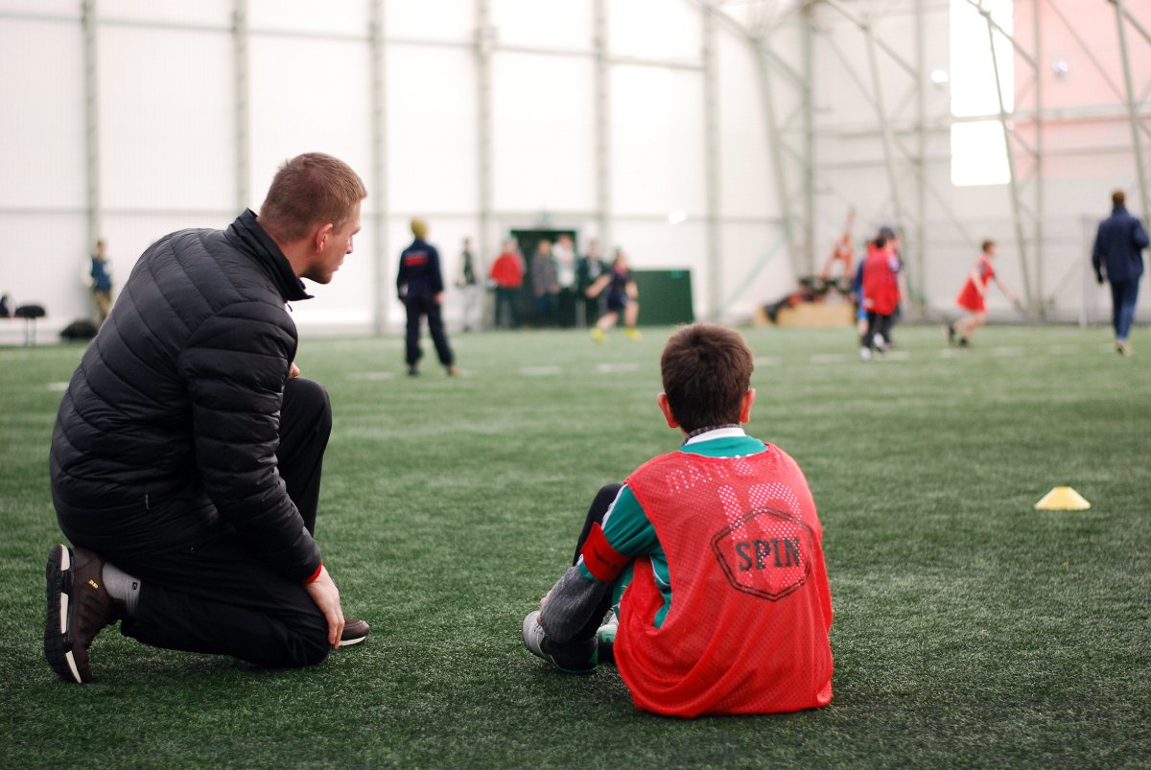
Foto: siseministeerium

Slide 8
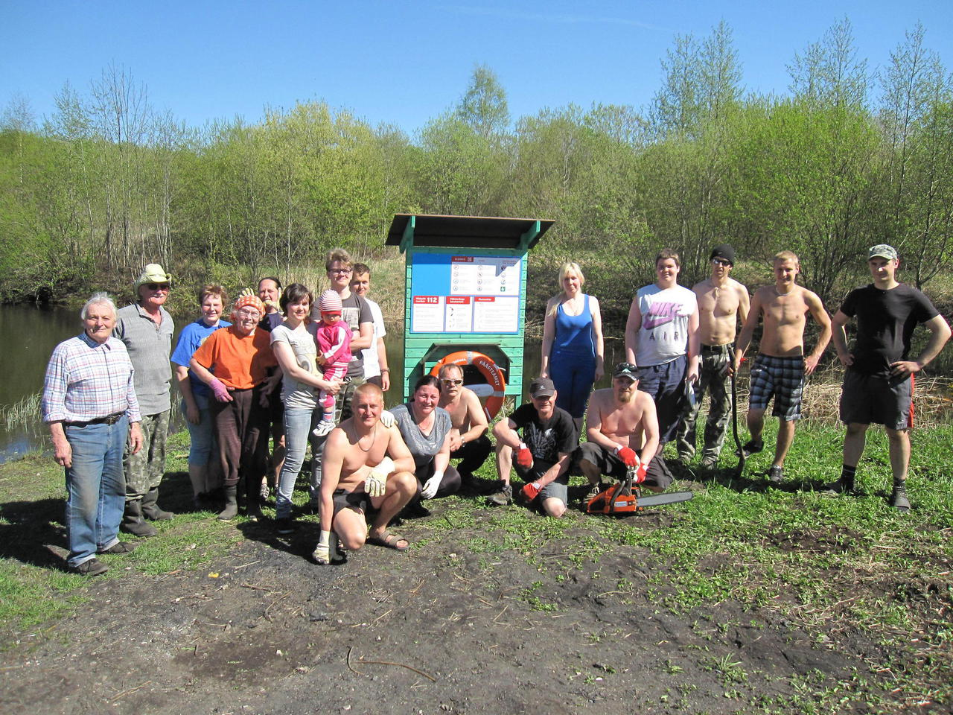

Slide 9
Festival of Opinion Culture
Photo. Arvamusfestival.ee

Slide 10
JUST ENABLE
responsibility
trust
civic education
structures and agreements
support as an investment – capacity building
public image

Slide 11
LACK OF RESOURCES FOR CAPACITY AND CAPACITY BUILDING
STRUCTURES WITHOUT SOCIAL DEMAND
PROCESS OR RESULTS?

Slide 12
Thank you!

