Slide 1
Community Engagement as an Investment to Local Development

Slide 2

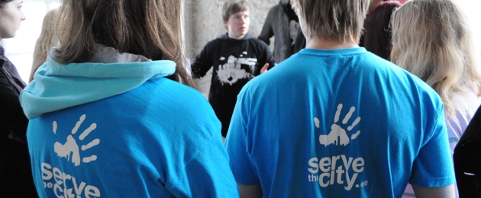
TRUST IN THE WISDOM OF CROWDS
People want to have strong community, nice living environment and well developed services
People have interest, ideas, proposals
People do contribute

Slide 3
Community development
Social interaction
Celebrations
Taking action
Visioning the future
Strategies
Finding solutions
Meetings
Events
Action days
Planning
Volunteering
Meetings and discussions
Networking

Slide 4
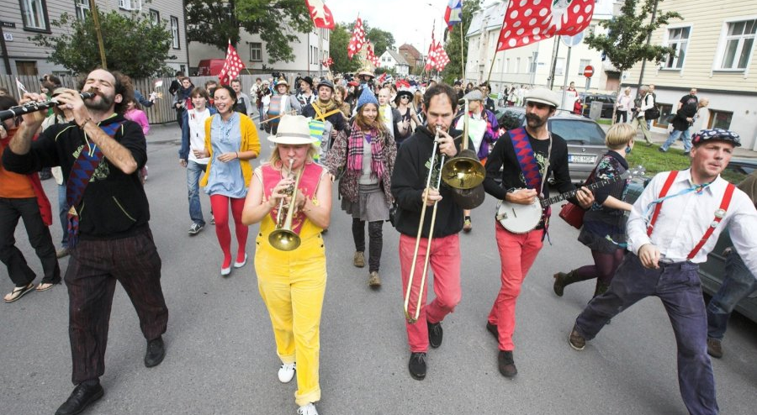
1. Celebrate: identity, reason to meet

Slide 5
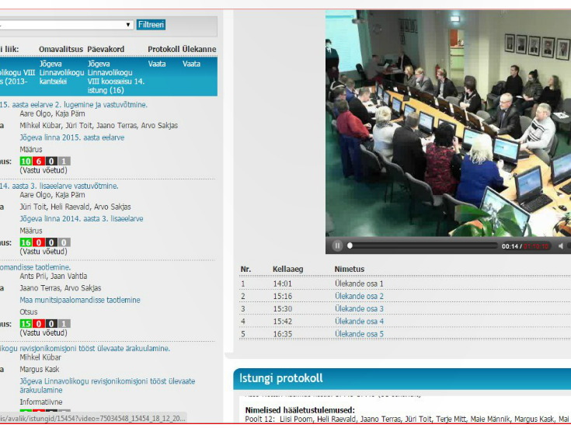
2. Involvement practices that do engage
Informing is a skill
Consultative bodies need to be meaningful
Going to the people
Keeping consultations simple

Slide 6
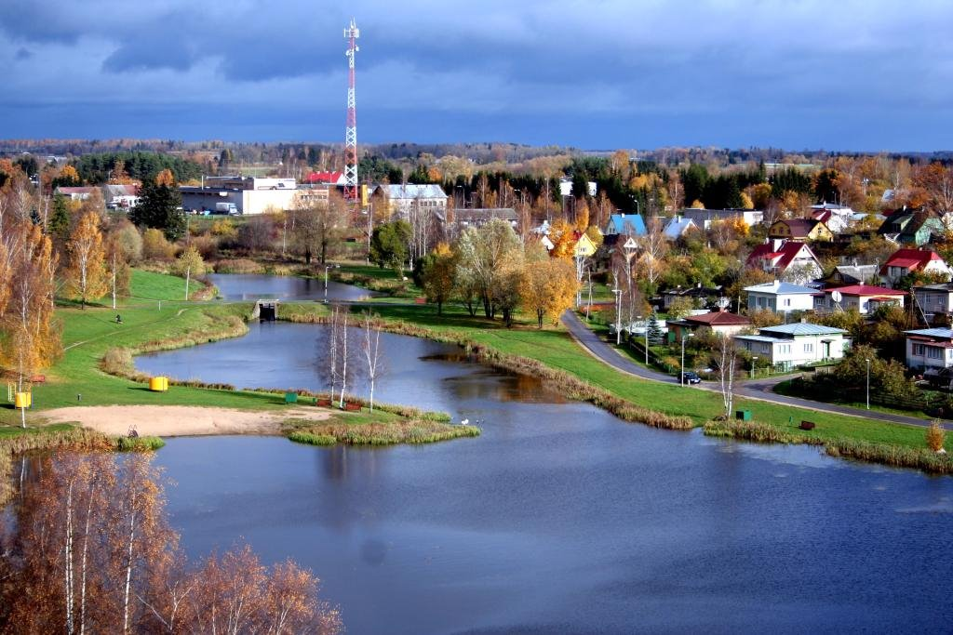
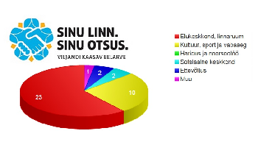
3. Give voice: participatory budgeting

Slide 7
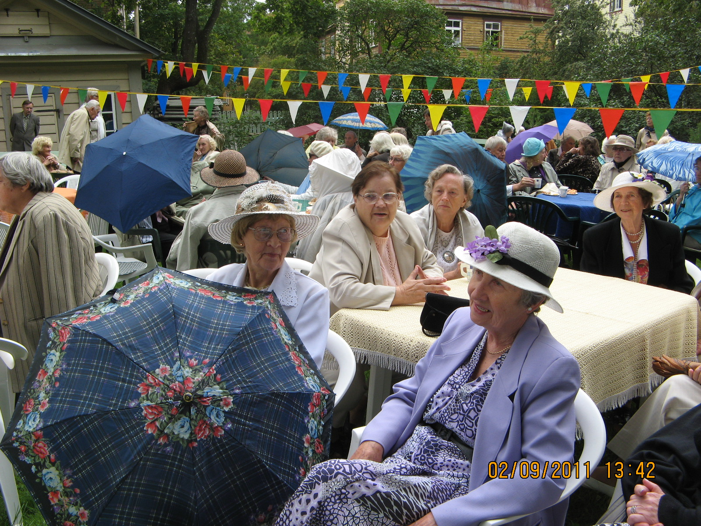
3. Support to local CSOs, volunteering
1. Know your CSOs
2. Cooperate: consultations, service provision and/or development, innovation
3. Support CSOs initiatives and capacity
4. Make participation meaningful

Slide 8
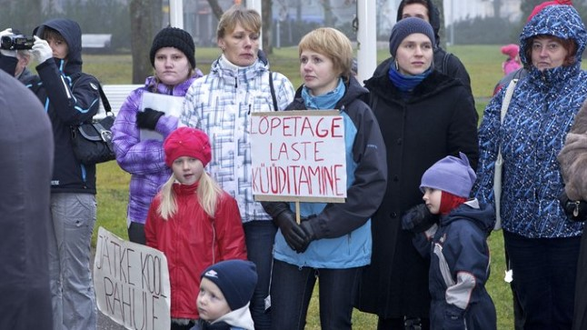
4. Empowering local people

Slide 9
Administrative reform
Community is a community
Stronger structures for involvement
Representation
Community services, delegation of services

Slide 10
Thank you!
Maris Jõgeva
Network of Estonian Nonprofit Organisations
info@ngo.ee, www.ngo.ee

