Slide 1
Notes:
INTERACTION BETWEEN GOVERNMENT authorities, institutes of CIVIL SOCIETY AND MASS MEDIA IN THE CONTEXT OF EUROPEAN INTEGRATION

Slide 2
Notes:
INTERACTION BETWEEN GOVERNMENT authorities, institutes of CIVIL SOCIETY AND MASS MEDIA IN THE CONTEXT OF EUROPEAN INTEGRATION

Slide 3
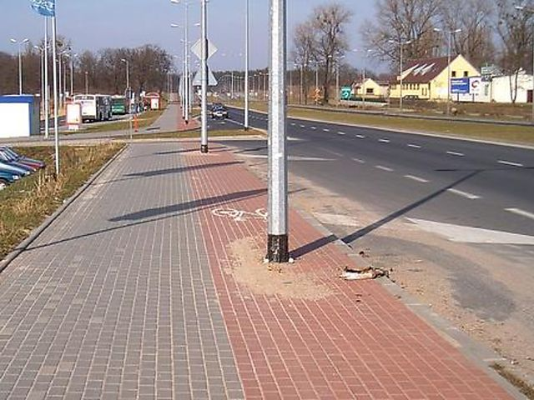
Notes:
We can divide and sub-divide our audiences
We can use: demographics; behavioural, attitudinal and preference modelling…
We can select those who are most likely to change
We know who they listen to (messengers)
We can analyse how best to reach them (channels)
We can respect diversity and inclusivity

Slide 4
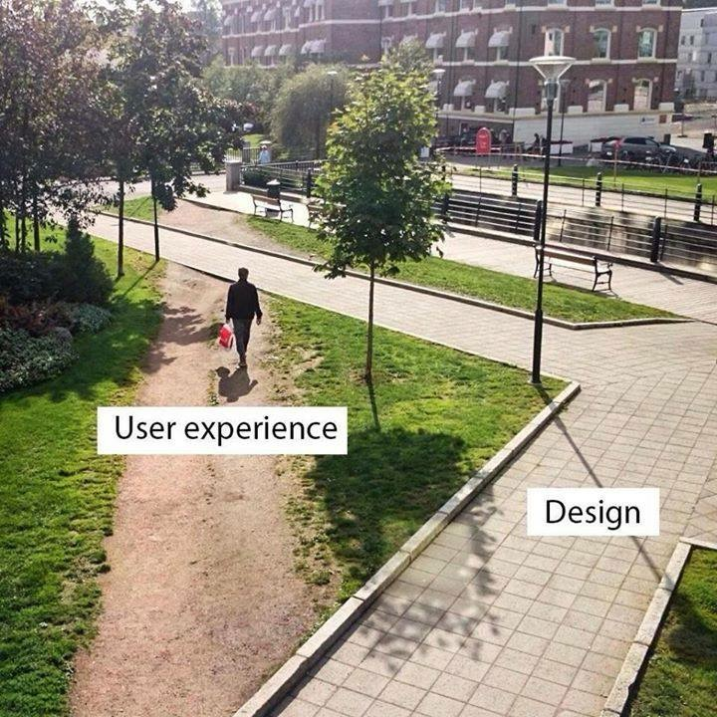
Notes:
We can divide and sub-divide our audiences
We can use: demographics; behavioural, attitudinal and preference modelling…
We can select those who are most likely to change
We know who they listen to (messengers)
We can analyse how best to reach them (channels)
We can respect diversity and inclusivity

Slide 5
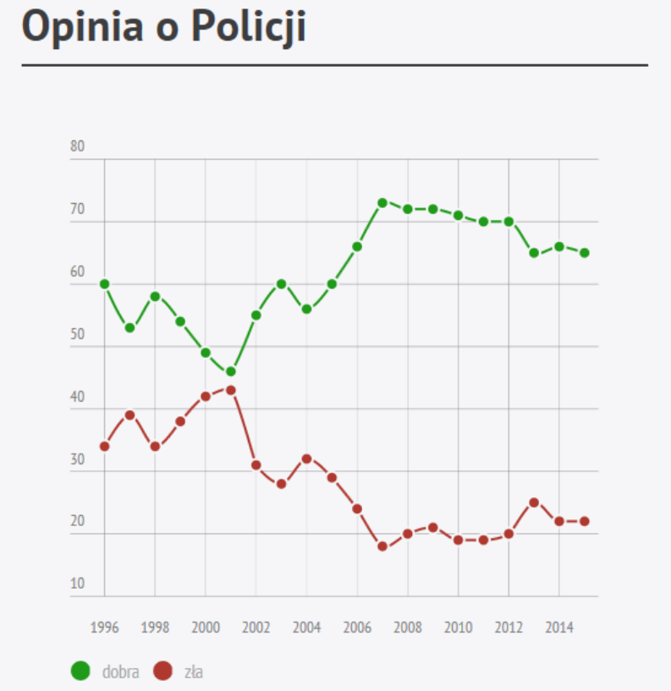
Notes:
Be professional
We can use: demographics; behavioural, attitudinal and preference modelling…
We can select those who are most likely to change
We know who they listen to (messengers)
We can analyse how best to reach them (channels)
We can respect diversity and inclusivity

Slide 6
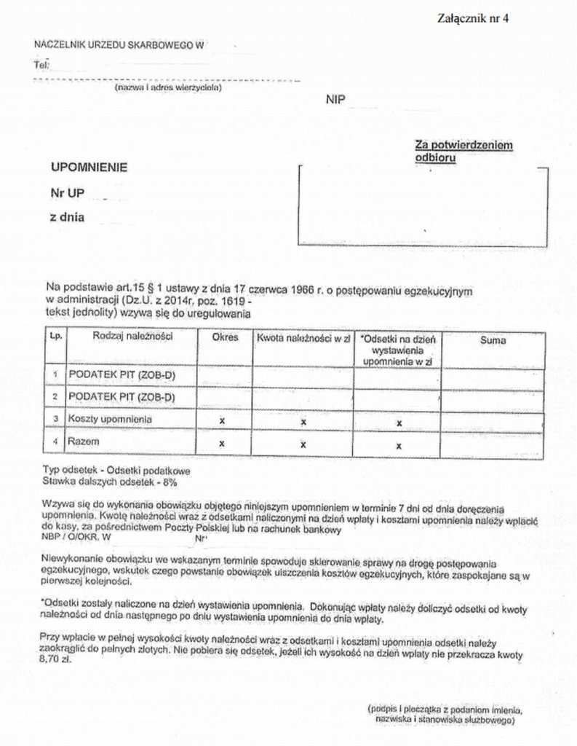
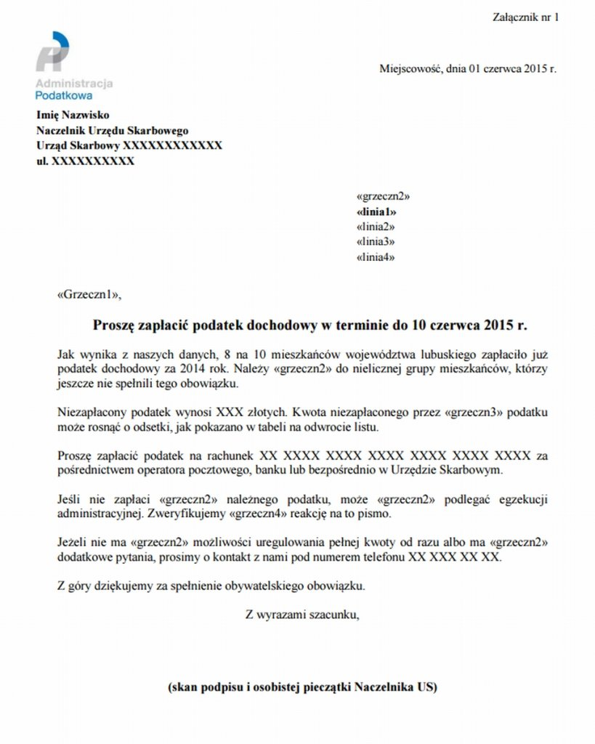

Slide 7
