Slide 1
Civil service system and public administration reform in the Republic of Azerbaijan
Kamil Bakhshaliyev
The State Examination Center
Chief consultant, Legal provision and HR Department

Slide 2
Azerbaijan is a democratic, legal, secular, unitary republic.
Political system is presidential republic.
State power in Azerbaijan is based on a principle of division of powers:
Executive power belongs to the President of the Republic of Azerbaijan;
Legislative power is implemented by Milli Majlis of the Republic of Azerbaijan exercises;
Judicial power belongs to the courts of the Republic of Azerbaijan

Slide 3
STATE POWERS
Legislative government
Executive government
Judicial government
President
Milli Majlis (Parliament)
Prosecutor General’s Office
Three-stage Court System
Constitutional Court
Office of the President
Cabinet of Ministers
Supreme Court
Central and local executive state bodies
Appeal courts
Specialized Courts
Courts of the first instance
General
Courts

Slide 4
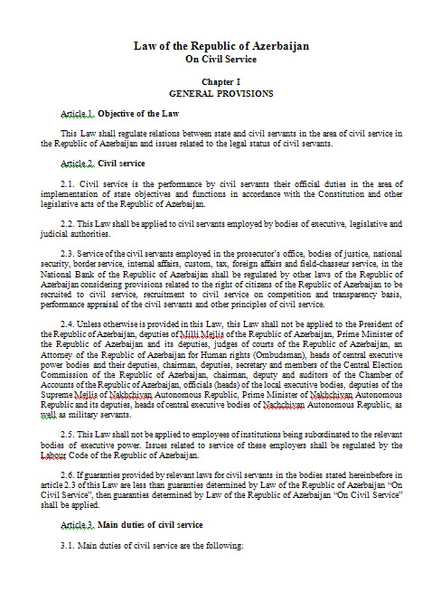
Law on Civil Service adopted on 21 July, 2000
Main issues of civil service are regulated within this law:
- Categories of state bodies
- Classification of civil service positions
- Duties, rights, restrictions of civil
servants
- Civil service recruitment
- Provisions of civil servants
- Performance appraisal of civil servants
- Professional development of civil servants

Slide 5
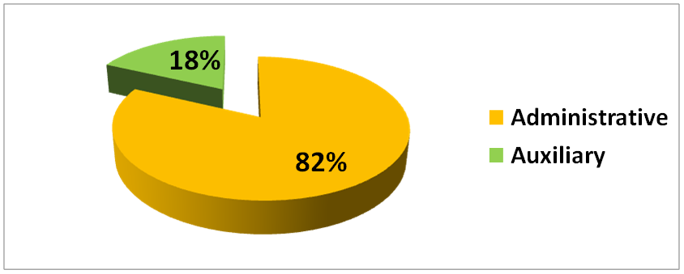
There are about 28 000 civil servants in Azerbaijan
Positions in state bodies are classified as administrative and auxiliary depending on subject of its functions.

Slide 6
Auxiliary positions (18%)
There are no procedures of recruitment for the auxiliary positions.
These positions are positions of civil servants carrying out the technical works in state bodies (clerk, typist, courier, archivist, lift operator, driver and other employees).
Administrative positions (82%)
Administrative positions are positions of heads of offices and departments of state bodies, their deputies, as well as positions of specialists recruited to the civil service.
These positions are divided into 8 classifications according to the categories of state bodies (from supreme-5).

Slide 7
Administrative positions in the 1st-4th classifications are the positions of:
heads and deputy heads of office of state bodies;
heads and deputy heads of departments of the central executive bodies and civil servants from the state bodies of the 1st and 2nd categories.
Administrative positions in the 5th-7th classifications are positions of:
heads of divisions and employees of the central executive bodies;
heads and deputy heads of departments in the state bodies subordinated to the central executive bodies;
all administrative positions in local departments of the central executive bodies.

Slide 8
Types of recruitment
Recruitment for the administrative position of the 1th-7th classifications could be done through:
internal interview
general interview
competition

Slide 9
Announcement of vacancies
Recruitment process starts with announcement of vacancies.
All announcements should confirm to the standard forms approved by the SEC.
An announcement covers:
job descriptions
full information about a vacancy (salary, working address, requirements, classification, etc.)
the recruitment process
In an internal interview is conducted then announcement must be given by a relevant state body. So, the SEC announces the vacancies for general interview and competition.

Slide 10
General Interview
Holding of the positions corresponding to the 1th-7th classifications of administrative positions in state bodies (except for local executive power bodies) by persons serving as civil servants in administrative positions in same or other state bodies and having professional rank corresponded to the administrative position classification, as well as persons having minimum 5 years service experience and working in administrative positions shall be carried out through an general interview.
It gives opportunity to make transfers and rotations of civil servants, and
re-recruitment of the ex-employees who left civil service and wants to come back.
General interviews are announced by the SEC and usually take about 2 month to be finished.

Slide 11
Internal Interview
Can be carried out by:
central executive bodies
local executive bodies
courts
The main goal of holding internal interviews is giving a chance to the civil servants who work in the state body to be promoted.
Every administrative civil servant in a state body can take part in this process.
Advantages of such type of recruitment are:
it gives equal chance to the employees
it takes less time and resources
as a result we have the best candidate promoted by the fair, transparent and effective methods

Slide 12
Competition
Competition is used for employment to the positions in:
central executive bodies and their local departments
courts
It is announced by the SEC and consists of 2 parts:
testing
interview
It is the most popular recruitment process in Azerbaijan civil service. More than 80% of all vacancies are held by the competitions.

Slide 13
Interviewing process is the same for the internal interview, general interview and competition.
Interviews are held by the interviewing panel, as usual, consisting of 3 members:
a representative of the SEC
a representative of the employer
a neutral expert
All the members of the panel are equal and free in evaluating, and all interviewers have been trained to develop interviewing skills.

Slide 14
In interview candidates are evaluated by their:
knowledge
professional ability
world-view
other professional skills
A candidate, who fulfilled at least 16 points of 20 possible, is considered as succeeded in the interview.

Slide 15
Transparency and Fairness
Announcement of the results of the test examination immediately after the examination
Live broadcast of test exam on the SEC's website
Involvement of independent experts for interview
The presence of observers at the interview from mass media and NGO

Slide 16
Transparency and Fairness
video recording of the interviewing process: gives opportunity of control the interview panel
Formation and development of the personnel reserve
Publication results of the interview on the website of the SEC on the day of the interview

Slide 17
Transparency and fairness
Appeal Commission
Publication of decision of the appeal commission on the website
appeal commission acting: gives a chance to exclude any unfair or unprofessional decision of the panel

Slide 18
LAST TRENDS IN THE FIELD OF PUBLIC ADMINISTRATION
Abolishment of state organizations and transferring their functions to the proper bodies
Establishment of public-legal entities
Amendments and changes in Law on Civil Service
Combining of some state bodies
Transition to regional government system
Expansion of the scope of e-services

Slide 19
Amendments and changes in Law on Civil Service
Recruitment will be applied to the 1th-7th administrative positions.
Certification system is being applied in recruitment process
- Candidates will get proper certificate after passing test exam
- Certificates will be differed according to group of positions
- Certificate will be eligible during 5 years
Civil servants will be involved to certification in every 5 years

Slide 20
TWINNING PROJECT
Twinning project on “Support to further reforms in civil service system of Azerbaijan” was launched in November, 2016
Partner country is Lithuania Republic
Main aims of the project are:
Development civil service system in Azerbaijan
Improve capacity, tools and efficiency of SEC to develop and implement new classification of positions
Development of recruitment, remuneration and performance appraisal systems according to new classification

Slide 21
Thank you for you attention
k.bakhshaliyev@dim.gov.az

