Slide 1
PUBLIC, TERRITORIAL AND ADMINISTRATIVE REFORMS
The Government of the Republic of Armenia
Ms. Mane Hakobyan
Leading specialist
Personnel Management Department of RA Government Staff
7-8 September 2017
Ukraine, Kiev

Slide 2
Brief information
1.Public administration
Modernisation of public administration
2.Territorial and administrative reforms in Armenia
(2015-2018)
Process
Interim results
Prospects

Slide 3
Modernisation of public administration
increase the official powers of the members of the RA Government ensuring that the sector entrusted to them is managed effectively, and introduce responsibility commensurate to it;
for all republican executive authorities define the focus of performance and rate them and introduce a new procedure for evaluating the efficiency of the activities of the territorial administration bodies;

Slide 4
identify and abolish excessive procedures for and layers of service delivery to citizens by public administration authorities, which contain minimum corruption risks and minimise undue interface with public authorities in routine life;
introduce new criteria for evaluation of the professional capabilities and performance evaluation of job responsibilities of public servants based on the imperative to drastically change the image of a public servant.

Slide 5
Territorial administration
develop and implement marz strategies and operational plans, in the context of marz and municipal development programmes targeted at the socioeconomic development of marzes funded by public and other sources, assess the impact and effectiveness of policies developed by the RA Government namely:

Slide 6
By the end of 2017, adopt the RA Marz Development Strategies for 2017-2025 and the first Operational Plan, attaching importance to public community-private partnership arrangemenys;
By the end of 2017, develop the concept paper for territorial administration, setting forth substantive changes in territorial administration and redefining the mission of territorial bodies;

Slide 7
during 2017-2019, continue administrative and territorial reforms, complete the process of community consolidation. In order to guarantee the success of reforms in this direction, the following measures are planned to be undertaken:
during 2017-2019, continue the administrative and territorial reforms, complete the process of community consolidation;
during 2017-2022, create intercommunity unions, and introduce different forms of intercommunity co-operation:

Slide 8
Major developments of Local Governance in Armenia
Renewed legal framework of local self government
Territorial and Administrative Reform in Armenia (TARA): consolidation of municipalities
Regional development strategy to foster balanced development
Considerable investment projects at local level
Continued donor technical and financial support to Armenia’s reforms from EU, USAID, BMZ/GIZ, SDC, UNDP etc.

Slide 9
Armenia at a glance:
Area: 29,800 sq. km
Capital: Yerevan
Population: ca. 3 million (2016)
Administrative 10 provinces and municipalities division: (incl. Yerevan)

Slide 10
Territorial and administrative fragmentation
Weak capacity and performance of local self-government bodies
Limited resources (human, financial, etc.)
Low level of service delivery at local level
Limited opportunities for territorial development
Limited leverage for decentralisation

Slide 11
Impact of tara
Improved local governance: informed decision-making, more public participation, transparency and accountability, etc.
Increased financial and human resources
More capable administrations and improved administrative services, innovative e-governance tools
Improved infrastructures
Advanced management tools and mechanisms
Expansion and improvement of public services

Slide 13
Municipal management information system
Initiative started in 2006
Unified information system consisting of:
numerous management systems, information resources, e-governance, e-participation and e-services components
Integrated with other state systems
Introduced and launched in over 550 municipalities in all 10 regions of Armenia
Over 4.000 municipal servants trained on the system
International awards :
Open Government Award 2015 (Mexico)
Georgian IT Innovation Award 2016

Slide 14
Public participation and engagement in local governance
Overall, 7,655 residents are registered for the SMS-polling in all 9 communities
Poll results helping mayors substantiate arguments for requesting additional resources
SMS polling has been included in 2014-16 Open Government Partnership Action Plan (2014-2016)

Slide 15
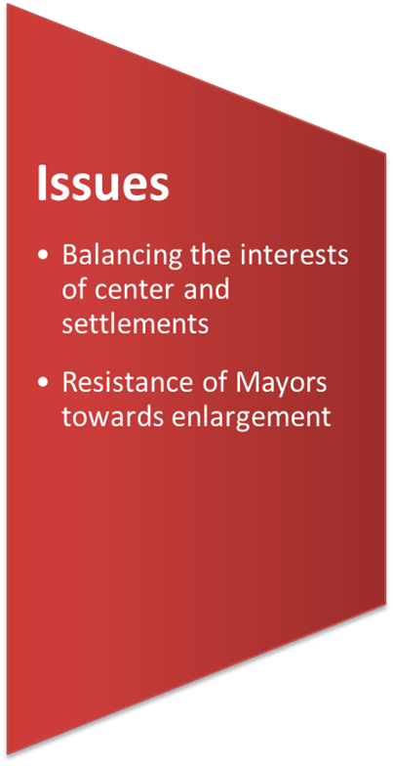
Lessons, issues and challenges

Slide 16
Prospects, beyond 2018

Slide 17
references
Government Staff of the Republic of Armenia: http://gov.am/en/
Ministry of Territorial Administration and Development of Armenia: http://mtad.am/en/
Armenia Territorial Development Fund: http://www.atdf.am/en/Home
Municipality MMIS-based website (example): http://ashtarak.am/Pages/Home/Default.aspx
SMS polling: http://smspolling.org/#
Open Government Partnership http://www.ogp.am/en/

Slide 18
THANK YOU FOR YOUR KIND ATTENTION!

