Slide 1
Professionalization of Service in Local Self-Government Authorities in the Context of Public Administration Reform and Decentralization of Power (Czech experience)
Jakub Jaňura
Department for Strategic Development and Coordination of Public Administration
Ministry of the Interior
Czech Republic
www.mvcr.cz
jakub.janura@mvcr.cz
Eastern Partnership; Working Group “Public Administration Reform”
Kyiv | Ukraine 6 - 7th September 2017

Slide 2
INTRODUCTION
EaP: Czech foreign policy priority
CZE: area of local governance and decentralisation
2 seminars per year
Why?
Common history reflected in PA development
To share PA experiences, promote democracy and good governance
By the way…
Acivities of Czech Development Agency
Transition assistance
Activities of Visegrad Fund
Visegrad 4 Eastern Partnership Programme
Eastern Partnership; Working Group “Public Administration Reform”
Kyiv | Ukraine 6 - 7th September 2017

Slide 3
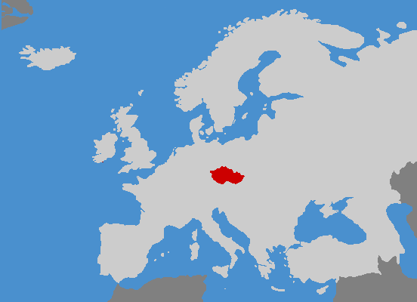
CZECH REPUBLIC
Area: 78,866 sq. km
Number of municipalities: 6,258
Population: 10.5 mil.
Average size of municipality: under 2,000 inhabitants
Employees in PA: approx. 69,000
GDP per capita: 19,800 USD
Parliamentary democracy, unitary state
Eastern Partnership; Working Group “Public Administration Reform”
Kyiv | Ukraine 6 - 7th September 2017

Slide 4
MINISTRY OF THE INTERIOR
Coordination and control of organisation and execution of public administration
Coordination role for ICT
Roles in relation to self-governments:
supervision, control, methodology, coordination, conception
Strategy in public administration
Contribution to execution of delegated (state) administration
Education of public administration officials
Registers of inhabitants, elections, registers of births and deaths
Civil service
Department responsible for conceptional and strategic activities of public administration in CZE – particularly Reviewing and optimizing the performance of public administration in the territory
Eastern Partnership; Working Group “Public Administration Reform”
Kyiv | Ukraine 6 - 7th September 2017

Slide 5
Current trends in PA in the Czech Republic
Stabilisation of system
Deconcentration and decentralisation is finished
Status of civil servants in legislation: Act on Civil Service (2014)
Evaluation of current state
Discussions (academic) of further development
Evolution, rather than revolution
Smaller, gradual changes (enhancements?)
Pilot projects before implementation
Establishment of methodological principles (process mapping etc.)
Political vulnerability of large-scale changes
Search for ideal effectivity/quality/accessibility
“new“ topic: accessibility of public services
“the world after European subsidies“
Eastern Partnership; Working Group “Public Administration Reform”
Kyiv | Ukraine 6 - 7th September 2017
5

Slide 6
Thank you for your attention
Jakub Jaňura
Department for Strategic Development and Coordination of Public Administration
Ministry of the Interior
Czech Republic
www.mvcr.cz
jakub.janura@mvcr.cz
Eastern Partnership; Working Group “Public Administration Reform”
Kyiv | Ukraine 6 - 7th September 2017

