Slide 1

Lessons Learned Functional Analysis
Workshop for Eastern Partnership Countries
Tbilisi, 20 April 2018
By Ansi Shundi

Slide 2

Content
Different models and stakeholders
Principles guiding functional reviews

Slide 3

Size and scope of FA
Any new structure represents a change!
What kind of change are we looking for?
“If you always do what you’ve always done, you’ll always get what you’ve always got.”
Henry Ford
Vertical vs Horizontal functional analysis

Slide 4
Defining the purpose
- Spending review (most EU countries after 2008, currently Montenegro & Ukraine)
- Simplification of procedures and effectiveness review (Albania 2005, Kosovo 2008-2010, Serbia 2016, Georgia 2017, Ukraine currently)
- Putting some order in the system and standardization of typical structures
- Implementation of structural reforms with horizontal effects (PIFC, EU Integration, policy planning, etc.)
- Just an experiment?? (Albania 2017)

Slide 5
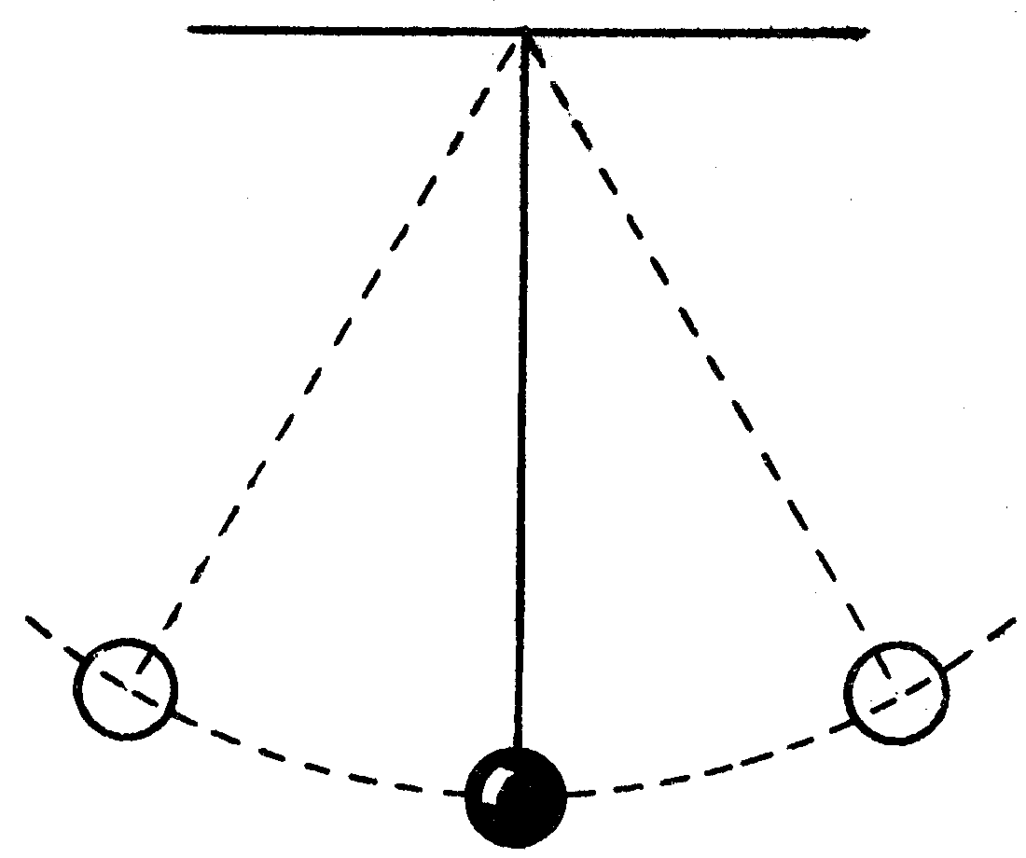
Stakeholders
- Political factor
- Technical / professional staff
- Centralization Vs. Discretion
- The importance of a central unit – Who could be the Central Unit?
- Key - Finding the right balance
Centralization
Discretion

Slide 6
Define the guiding principles
General rule – Never start a FA without your guiding principles. You risk to do more harm than good!

Slide 8
LEAD
VISION
Regulation
Policy
Finance
DIRECT
MISSION
Excellence
Activity
Organization
MANAGE
OBJECTIVES
Time
Scope
Cost
OPERATE
OUTCOME
Process
Product
Resources

Slide 9
Principles for consideration
- Start from the function, not the box in the organogram
- Review the portfolio as a whole (ministry + agencies + local branches + SOE)
- In case of large reviews, create clusters of institutions
- Review and group the functions by their nature and policy area
- Consider focusing the ministry on policy and development and shift implementation and service delivery to agencies

Slide 10

Management span
- Difficult to find the right balance
- Principle – Higher in hierarchy, smaller the number of direct subordinates. Lower in hierarchy, bigger the number of subordinates

Slide 11
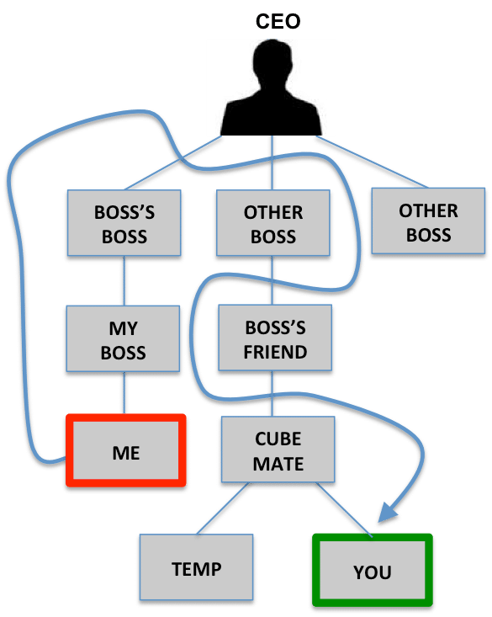
Delegation and Management Layers
- Delegation of functions is always good!
- Avoid too many management layers – at the end you need the workforce!!
- 3-4 management layers should be enough in institutions with 100-130 employees.

Slide 12
Keep the focus!
- The need for political attention to all policy areas within the portfolio!
- Prioritize the resources for core functions
- Always ask – What is the reason for this institution to exist? Core functions Vs. support functions

Slide 13
Quantitative analysis
- Business processes analysis
- Streamline and simplification
- Resources and
- Capacities

Slide 14
Conclusion
Functional reviews are not a democratic process and decisions can be painful
No Decision – Worst decision!
Carpe Diem and keep going!
Thank you for the attention! Ansi Shundi
shundi@cpmconsulting.eu

